Slide 1
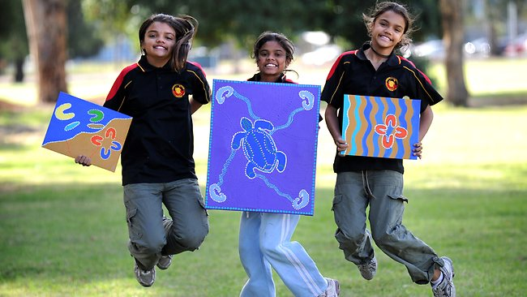
Enabling Aboriginal Students to Not Just Succeed but to Flourish: What Research Says.
Leading Educators Around the World (LEAP) Conference 2014.
Presented by Professors Rhonda Craven, Alex Yeung, Janet Mooney, & Dr Anthony Dillon
Institute for Positive Psychology and Education, Australian Catholic University

Slide 2
Background
There is an ongoing concern among government, leading Indigenous educators, and Indigenous organisations that there is little empirical research in Aboriginal Education that identifies the best strategies for promoting successful educational outcomes for Aboriginal students.
We at CPPE believe that a dearth of empirical Aboriginal Education research is impeding progress in addressing the educational disadvantage that Aboriginal children suffer and development of new solutions for interventions aimed at enhancing the educational outcomes of Aboriginal students.
Unlike much of the previous literature that focuses on what is wrong in Aboriginal education (i.e. the deficit model), research at CPPE investigates the potential positive influences affecting the success of Aboriginal students rather than those that thwart their achievement

Slide 3
Current Research
IPPE is currently involved in two Aboriginal Education research studies:
Seeding Success for Aboriginal Australian Primary Students
  ARC Linkage Grant in partnership with the Department of Education and Communities (DEC)
Cultivating Capability: Explicating What Works for Gifted Aboriginal Primary and Secondary Students
    UWS partnership grant with the Department of Education and Communities (DEC)

Slide 4
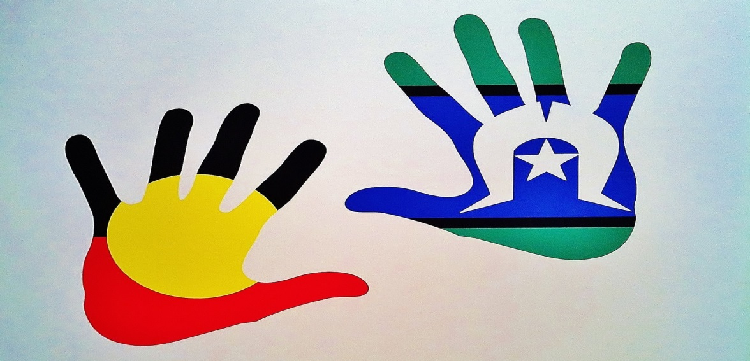
Seeding Success for Aboriginal Primary Students

Slide 5
Overview
Background: Positive research directions
Methodology
Academic Self-concepts
Teaching Strategies
Classroom Climate
Cultural & Aboriginal Education
Causal Ordering
Conclusions and Recommendations

Slide 6

Purpose
To identify and test the salience of an array of positively orientated educational and psycho-social variables that may seed success for Aboriginal students
Positive research directions
Aboriginal Educational Research has traditionally been too focused on reactionary deficit orientations (Mellor & Corrigan, 2004).
Simply continue to (re)identify deficits? Or adopt a strengths based approach ?

Slide 7
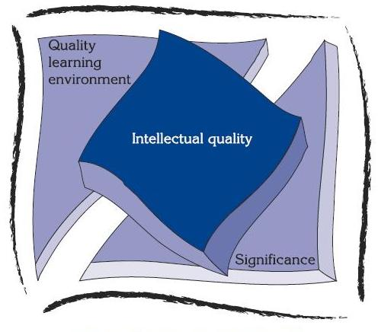
Identifying Educational Positivity
Three key documents served as guides for this research:
1. Quality Teaching Framework – 2. Visible Learning - 3. Freeing the Spirit
(NSW DET, 2003) (Hattie, 2009) (NSW AECG, 2004)
1. Quality Teaching Framework
Intellectual Quality: the focus is on practices that promote higher-order thinking;
Quality Learning Environment: the focus is on the learning environment that promotes positive relations and high expectations; and
Significance: the focus where learning becomes personally meaningful for each student.
Figure 1. The Quality Teaching Framework Model (NSW DET, 2003, p. 8)

Slide 8
Visible Learning
Analysis of over 800 meta-analyses (52,637 studies targeting many millions of students).
  138 potential drivers of achievement (with only 66 ‘worth having’).
  Identified six overarching themes that could seed success.
1. The child;
2. Home;
3. School;
4. Curricula;
5. Teacher; and
6. Teaching approaches.
The two most significant contributors towards student achievement were the students themselves and positive teaching practice.
Key Seeds of Success

Slide 9
Freeing the Spirit: Dreaming an Equal Future
The review of NSW Aboriginal Education practice (NSW AECG & NSW DET, 2004)
    Identified determinants of Aboriginal student success across 200+ sites;
    Found strong ‘pockets’ of educational and community commitment to the educational success.
    Nine key themes emerged to advance Aboriginal education and policy.
1. Strengthening policy, planning and implementation;
2. Extending quality teaching and learning;
3. Fortifying identities of Aboriginal students;
4. Engaging Aboriginal students;
5. Applying Aboriginal cultural knowledge;
6. Collaborating in partnerships;
7. Building community capacity;
8. Challenging racism; and
9. Advancing leadership and accountability.
Drivers of the Seeding Success research

Slide 10
The Seeding Success Model
Key factors identified in the previous research that were shown to seed success in Aboriginal Students:
Academic Self-concepts;
Teaching Strategies;
Classroom Climate; and
Cultural and Aboriginal
Education Strategies.
The Student
Engagement
and
Achievement
The Teacher
Academic Self-concepts
Cultural/ Aboriginal Education
Teaching Strategies
Classroom Climate

Slide 11
Methodology
Partial sequential mixed-method approach guided by research and theory
Quantitative component
Sample of 52 schools with a total of 5 or more Aboriginal students in Years 3 to 6. (Aboriginal n =495 and non-Aboriginal n =783).
Students in each school completed a survey on 3 occasions 4 months apart over a school year.
Stage Approach: Validity → Difference testing → Relations with outcomes
Qualitative component
4 DEC Schools selected based on scrutiny of quantitative data. Aboriginal students in these schools:
Achieved above-average reading comprehension and mathematics EMSAD scores;
Displayed higher levels of school engagement, and
Perceived that their culture was respected in the school learning environment

Slide 12
Academic Self-Concept
Internationally, research has found positive links between specific domains of academic self-concepts to matching achievement outcomes (see Marsh & Craven, 2006 for an overview);
Only recently has Aboriginal Education research found similar effects for Aboriginal high school students (e.g., Bodkin-Andrews, Dillon, O’Rourke, Craven, & Yeung, 2012; Craven & Marsh, 2005).
The Seeding Success Project sought to identify if these effects could be generalised to Aboriginal primary school students.
Academic Self-Concept Measures
Factor | Example Item
Academic Self-concept | I learn things quickly in all school subjects
Reading Self-concept | I am good at reading
Math Self-concept | Work in mathematics is easy for me
Notes:
International research has repeated found positive links between specific domains of academic self-concepts (e.g., math Self-concept) to matching achievement outcomes (e.g., math grades/test scores) (see Marsh & Craven, 2006 for an overview);
Only recently has Aboriginal Education research has found that academic self-concepts are significantly and positively associated with higher levels of achievement and engagement for Aboriginal students (e.g., Bodkin-Andrews, Dillon, O’Rourke, Craven, & Yeung, 2012; Craven & Marsh, 2005).

Slide 13
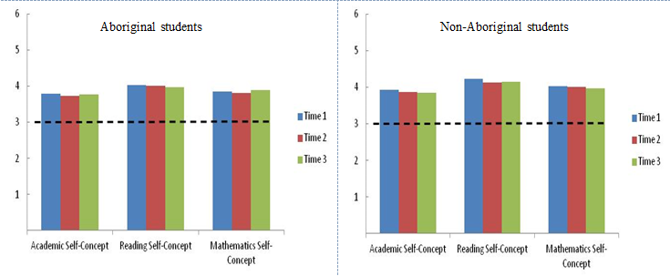
Validity of Academic Self-concept Measures
 | Assumptions | Met? | Notes
Reliability | Estimates > .70 | Yes | Ranged from .92 to .95 for Aboriginal and non-Aboriginal students.
Loadings | Loadings > .30 | Yes | Ranged from .68 to .90 for all students across three time-waves
Correlations | Correlations < .90 | Yes | Between factor correlations ranged from .23 to .76
Goodness of Fit | CFI > .90; RMSEA < .05 | Yes | CFI = .98 and the RMSEA = .07
Invariance | CFI change < .01 | Yes | All Invariance assumptions met.
Differences across Aboriginal and Non-Aboriginal Students
Aggregated mean scores across three time waves.
All students held positive scores
Evidence that non-Aboriginal students held higher self-concepts (small but significant).
Aboriginal students
Non-Aboriginal students

Slide 14
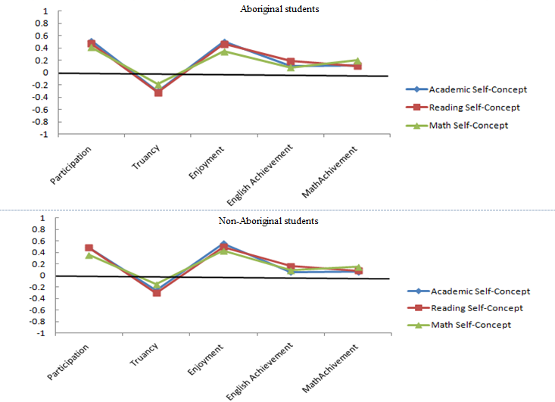
Relations between Engagement and Achievement
Aggregate correlations across three time-waves for Aboriginal and non-Aboriginal students.
For both student groups, the three domains of academic self-concept are positively related to higher levels of classroom participation, school enjoyment, and English and math achievement.
Negatively related to increased patterns of truancy.

Slide 15
Teacher and Student Voices for Academic Self-concepts
A clear theme to emerge from the qualitative data was the relation between quality teaching and a heightened sense of self-concepts for Aboriginal students. For example:
Once they're achieving they're going "Whoa … Oh yes I can do this after all" after me going "You can do this. You can do this. I know you can do this." But sometimes they have to believe it themselves (Teacher – School 2)
The successes have been more with the confidence with the children and feeling happy to contribute and to have their say and feel valued. I feel that they feel valued and that is reflected in the way they do the work and the way they relate with the teachers (Teacher – School 4).
This theme was evident for the Aboriginal students themselves, who recognised and appreciate how quality teaching has a positive impact on their achievement and themselves. “They help us learn. They’re just good teachers” (Student – School 2).

Slide 16
Teaching Strategies
Hattie (2009) found that the most frequent set of positive and meaningful predictors emanated from the teachers: “it’s the differences in the teachers that make the difference in student learning” (2009, p. 236).
Australian research into the Quality Teaching Framework has found that intellectual learning strategies are associated with higher levels of achievement for Aboriginal and non-Aboriginal students (Amosa, Ladwig, Griffiths, & Gore, 2007).
Teaching Strategies Measures
Factor | Example Item
Performance Feedback | My teacher lets me know when I have used the right way to do my work
Self-monitoring | My teacher encourages me to learn from past mistakes
Clear Instructions | My teachers' explanations about how to do school work are clear
Challenge | My teacher sets school work that is challenging
Literacy Scaffolding | My teacher builds on what I know about reading to teach me new things
Questioning | My teacher asks me questions to help me learn
Deep Understanding | I get to look at things in different ways
Notes:
International research has repeated found positive links between specific domains of academic self-concepts (e.g., math Self-concept) to matching achievement outcomes (e.g., math grades/test scores) (see Marsh & Craven, 2006 for an overview);
Only recently has Aboriginal Education research has found that academic self-concepts are significantly and positively associated with higher levels of achievement and engagement for Aboriginal students (e.g., Bodkin-Andrews, Dillon, O’Rourke, Craven, & Yeung, 2012; Craven & Marsh, 2005).

Slide 17
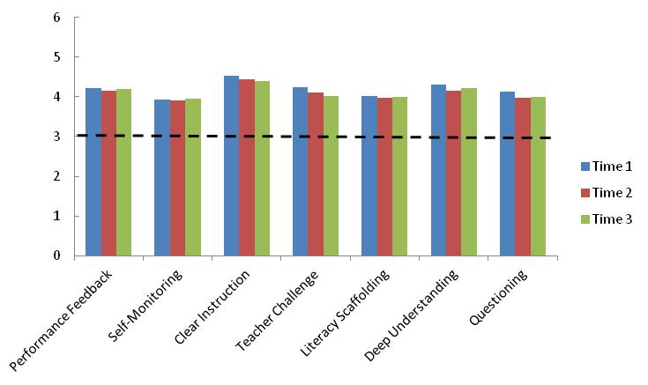
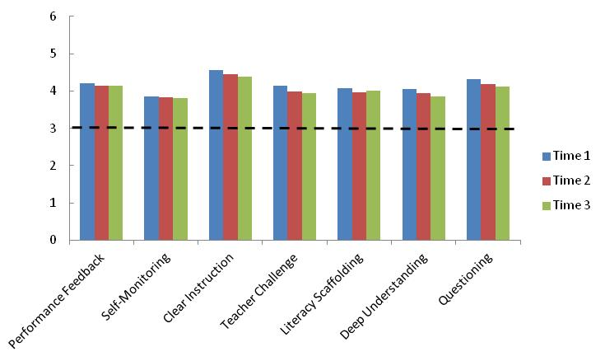
Validity of Teaching Strategy Measures
 | Assumptions | Met? | Notes
Reliability | Estimates > .70 | Yes | Ranged from .62 to .87 for Aboriginal and non-Aboriginal students.
Factor Loadings | Loadings > .30 | Yes | Ranged from .37 to .82
Correlations | Correlations < .90 | Yes | Ranged from .35 to .93 (only three of 210 correlations above .90)
Goodness of Fit | CFI > .90, RMSEA < .10 | Yes | CFI = .99 and the RMSEA = .03
Invariance | CFI change < .01 | Yes | All Invariance assumptions met (.003 change).
Differences across Aboriginal and Non-Aboriginal Students
Mean scores across three time waves.
All Aboriginal students held positive scores
Aboriginal students held higher mean scores than non-Aboriginal students for Self-Monitoring, Teacher Challenge, and Deep Understanding
Aboriginal students
Non-Aboriginal students
Aboriginal students
Non-Aboriginal students

Slide 18
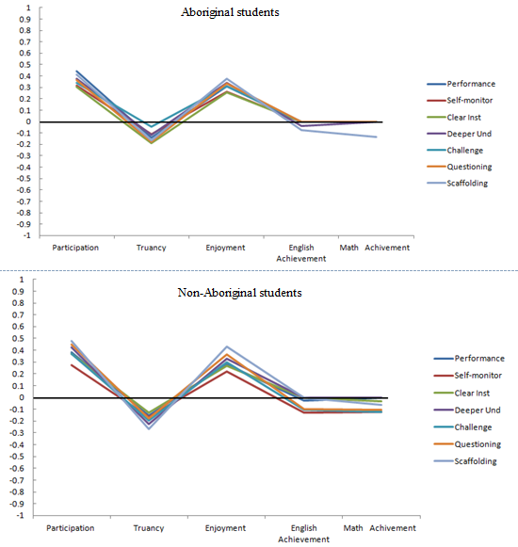
Relations between Engagement and Achievement
Aggregate correlations across three time-waves for Aboriginal and non-Aboriginal students.
For both student groups, the seven teaching strategy factors were positively related to higher levels of classroom participation and school enjoyment.
Negatively related to increased patterns of truancy.
Largely null relations with Achievement outcomes.

Slide 19
Teacher and Student Voices for Teaching Strategies
Students showed not only a clear awareness of varying teaching strategies, but also how these strategies were valued by the students themselves.
… they’ve pushed me to learn … if I hadn’t had those teachers I wouldn’t be like how I am now … the learning strategies and the way the teachers help us learn … they never back down and they help us with things, not only at school but with our home (student – School 1).
Across all four schools, the majority of teachers’ voices showed evidence for the use of deeper and higher-order learning strategies within the classroom. In addition, it was recognised that these strategies had positive effects on the learning styles, engagement, and achievement of Aboriginal students.
I think that's helped him to realise that he is not just regurgitating answers, he's being a good student … he thought that just knowing facts was being a good student … trying to get him to analyse information and explain why he has done things and not just give me the right answer because that's not all that is important in life. It's the process… (teacher, school 3)

Slide 20
Classroom Climate
The Quality Teaching Framework emphasised that positive learning strategies should be situated in learning environment that promotes positive relations within the classroom (NSW DET, 2003).
Research suggests that strong positive relations between students and teachers is not a one way process (Byrne & Munns, 2012). Humour, flexibility, caring, and understanding are cited as essential characteristics to adaptive learning environments for Aboriginal students (Buckskin, 2012; Harrison & Greenfield, 2011).
Classroom Climate Measures
Factor | Example Item
Learning Fun | My teacher has a good sense of humour
Rapport | My teacher likes me
No Shame | My teacher never makes me feel shamed / embarrassed about work in class
Order | In class, students can usually keep quiet when my teacher wants them to
Collaborate | Students in my class help each other learn
Notes:
International research has repeated found positive links between specific domains of academic self-concepts (e.g., math Self-concept) to matching achievement outcomes (e.g., math grades/test scores) (see Marsh & Craven, 2006 for an overview);
Only recently has Aboriginal Education research has found that academic self-concepts are significantly and positively associated with higher levels of achievement and engagement for Aboriginal students (e.g., Bodkin-Andrews, Dillon, O’Rourke, Craven, & Yeung, 2012; Craven & Marsh, 2005).

Slide 21
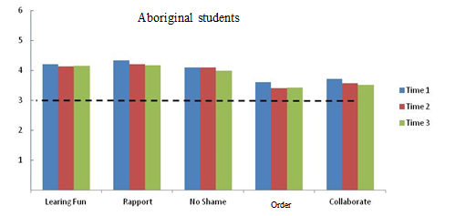
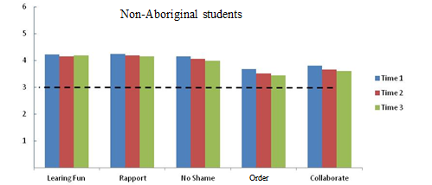
Validity of Classroom Climate Measures
 | Assumptions | Met? | Notes
Reliability | Estimates > .70 | Yes | Ranged from .70 to .84 for Aboriginal and non-Aboriginal students.
Factor Loadings | Loadings > .30 | Yes | Ranged from .44 to .91 for all students.
Correlations | Correlations < .90 | Yes | Ranged from .18 to .80.
Goodness of Fit | CFI > .90, RMSEA < .10 | Yes | CFI = .99 and the RMSEA = .03.
Invariance | CFI change < .01 | Yes | All invariance assumptions met (.003 change).
Differences across Aboriginal and Non-Aboriginal Students
Mean scores across three time waves.
All students held positive scores
Aboriginal students held higher mean scores (small but significant) for No Shame, Classroom order, and Classroom collaboration.
Aboriginal students
Non-Aboriginal students

Slide 22
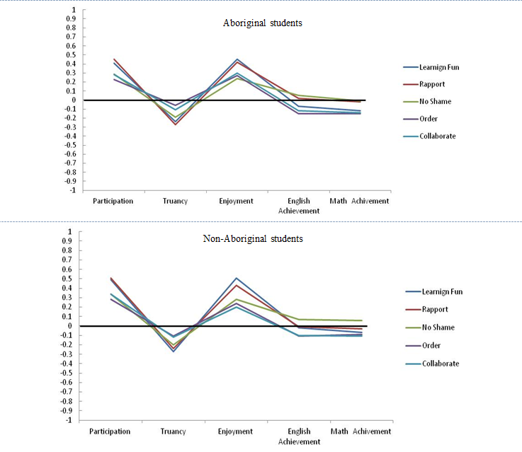
Relations between Engagement and Achievement
Aggregate correlations across three time-waves for Aboriginal and non-Aboriginal students.
For both student groups, the five classroom climate factors were positively related to higher levels of classroom participation and school enjoyment.
Negatively related to increased patterns of truancy.
Largely null relations with achievement outcomes.

Slide 23
Teacher and Student Voices for Classroom Environment
A subtle, underlying theme emerged suggesting that a positive classroom was conducive to student learning. This theme is most clearly identified by the trust and value the students held for their teachers and their classrooms.
Teachers helped us change because they have a good understanding of us and they share the same feelings with us and so they help us learn more (student, school 1)
It is a very good school, because they help us out. The school is very active. [It] is the best school, because when we get stuck the teachers look out for us (student, school 3).
Similarly teachers recognised the importance of positive classroom relationships.
You have to connect … build a relationship with that child, care about them as your teacher … not friendship like, it is a particular way you do that as a teacher. If you want to be a good teacher [for Aboriginal students], number one that child has to know that you actually care. (AEO, school 2).

Slide 24
Cultural and Aboriginal Education Strategies
Purdie et al. (2000) found that Aboriginal students’ sense of self-identity was closely tied to knowledge of kinship, Aboriginal history, languages, traditional practices, and Country. After family, teachers played the strongest roles in promoting identity.
Although Amosa et al. (2007) found evidence suggesting that significance (e.g., cultural relevance) was counterproductive to closing the gap in achievement, a deeper examination found that schools were largely failing to commit meaningful inclusive practices.
Cultural Education Measures
Factor | Example Item
Community Involvement | Aboriginal people from our community visit our class to teach us about Aboriginal history and culture
Cultural Knowledge | In my class we learn about Aboriginal culture
Inclusive Perspectives | My teacher has taught us about Aboriginal art
Cultural Diversity | In my class we learn about people from different cultures
Strength of Cultural Identity | I feel good about my culture when I am in class
Relations with Family/Community | My teacher knows my family
Cultural Sensitivity | My teacher has a good understanding of my culture
Notes:
International research has repeated found positive links between specific domains of academic self-concepts (e.g., math Self-concept) to matching achievement outcomes (e.g., math grades/test scores) (see Marsh & Craven, 2006 for an overview);
Only recently has Aboriginal Education research has found that academic self-concepts are significantly and positively associated with higher levels of achievement and engagement for Aboriginal students (e.g., Bodkin-Andrews, Dillon, O’Rourke, Craven, & Yeung, 2012; Craven & Marsh, 2005).

Slide 25
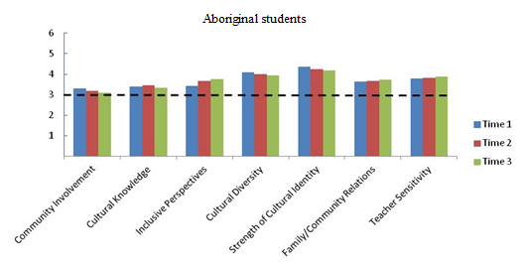
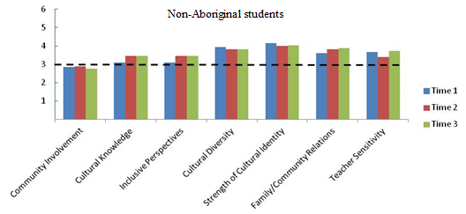
Validity of Cultural Education Measures
 | Assumptions | Met? | Notes
Reliability | Estimates > .70 | Yes | Ranged from .69 to .90 for Aboriginal and non-Aboriginal students.
Factor Loadings | Loadings > .30 | Yes | Ranged from .46 to .85 for all students
Correlations | Correlations < .90 | Yes | Ranged from .12 to .88
Goodness of Fit | CFI > .90, RMSEA < .10 | Yes | CFI = .98 and the RMSEA = .03
Invariance | CFI change < .01 | Yes | All invariance assumptions met (.002 change).
Differences across Aboriginal and Non-Aboriginal Students
Mean scores across three time waves.
All Aboriginal students held positive scores
Evidence suggested that Aboriginal students held higher mean scores for Community Involvement, Cultural Knowledge, Inclusive Perceptions, Cultural Diversity, and Strength of Identity, whereas non-Aboriginal students held higher scores for Family/Community relations
Aboriginal students
Non-Aboriginal students

Slide 26
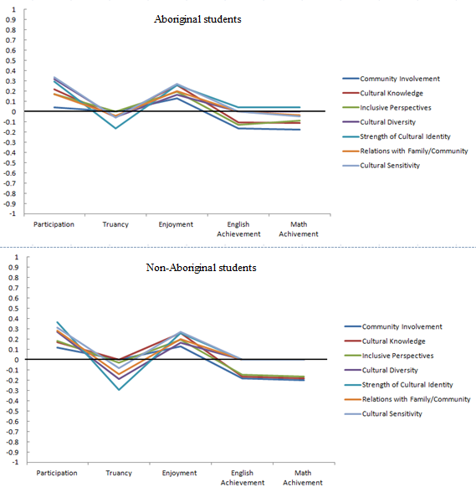
Relations to Engagement and Achievement
Aggregate correlations across three time-waves for Aboriginal and non-Aboriginal students.
For both student groups, most of the Cultural Education factors were positively related to higher levels of classroom participation and school enjoyment.
Most were negatively related to increased patterns of truancy.
Evidence for null and some negative relations with achievement outcomes.

Slide 27
Teacher and Student Voices for Cultural Education
Across all four schools, one of the strongest themes to emerge centred around strategies capturing the value of cultural learnings and support, and involvement of the local community:
I think one of the remarkable things about the Aboriginal community is that they want our school to teach the children, so that they’re equipped for this modern world and can keep their cultural learnings too (Principal – School 4) .
Link and Learn. It’s Aboriginal role models … talking to the kids about their job, and how they used literacy and numeracy in their job. They’re Aboriginal people working in the community, some of our Elders just come in and talk about their life, and their dreaming stories … [Teacher – School 3].
Most promising about these findings was that across all four schools, Aboriginal students were proud and confident about their culture within the classroom:
It makes us feel confident after we’ve just done something that’s just on our ancestors and I feel good … it makes you feel good that you can share it with non-Aboriginal people and show them the way the old people used to do it (student – School 1).

Slide 28
Causal Ordering
Although correlational results may provide insights as to the degree the predictors (e.g., Teaching Strategies) may be associated with both the objective and subjective schooling outcomes, little can be said as to whether predictors actually predict the outcomes, or do higher levels of the outcomes predict a greater likelihood of perceiving the predictor itself.
To answer this question, a SEM causal ordering and reciprocal effects approach was taken (see Marsh, Byrne, & Yeung, 1999).

Slide 29
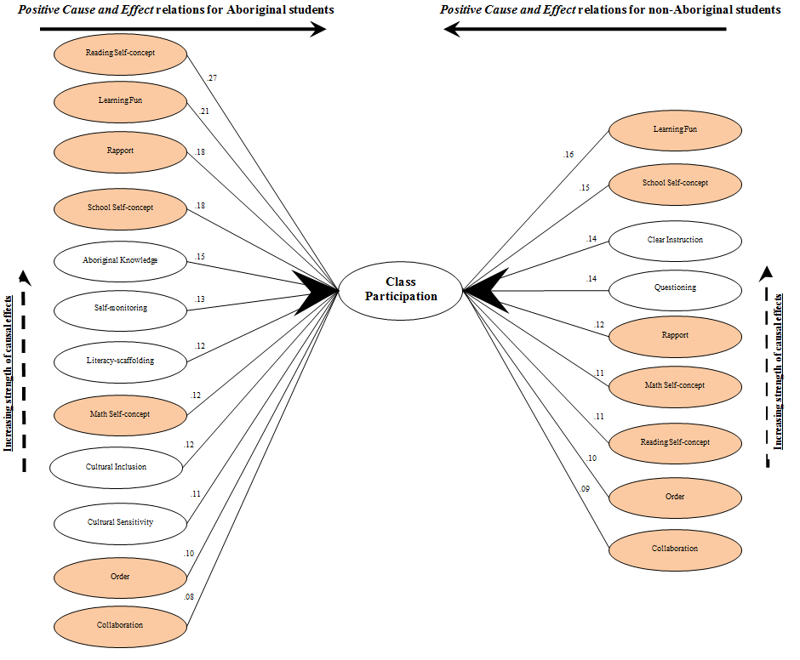
Causal Ordering for Classroom Participation
Identifies significant causal effects in increased levels of Classroom Participation.
12 variables had a causal impact for Aboriginal students, 9 for the non-Aboriginal students.

Slide 30
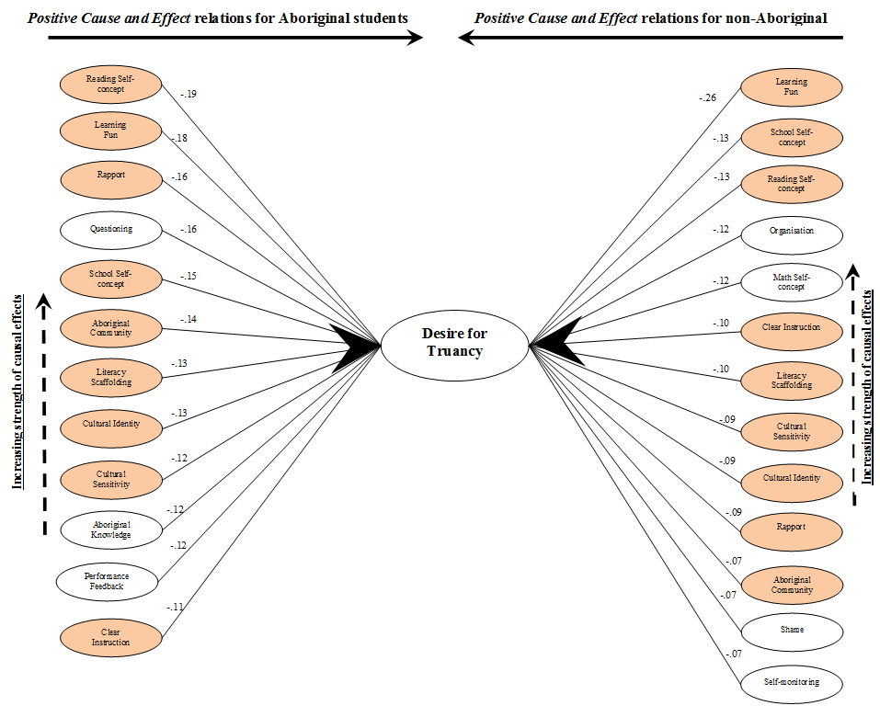
Causal Ordering for Truancy
Identifies significant causal effects in decreasing levels of Truancy .
12 variables had a causal impact for Aboriginal students, 13 for the non-Aboriginal students.

Slide 31
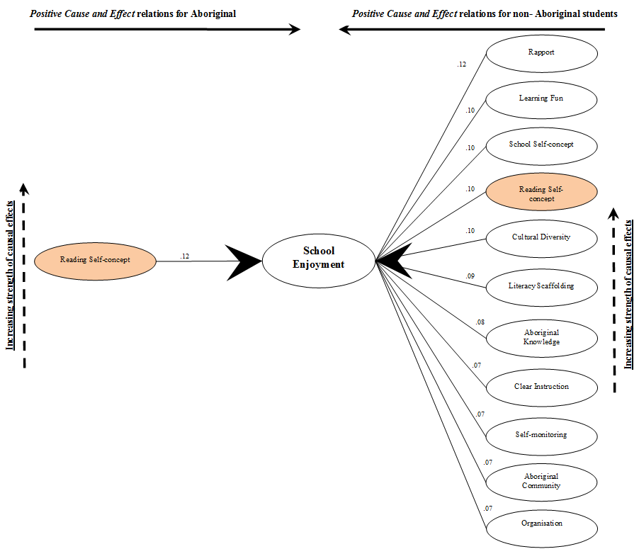
Causal Ordering for School Enjoyment
Identifies significant causal effects in increasing levels of School Enjoyment.
Only 1 variable had a causal impact for Aboriginal students, yet 11 for the non-Aboriginal students.

Slide 32
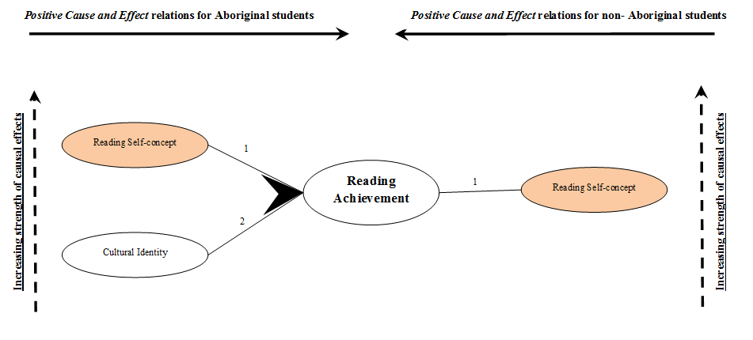
Causal Ordering for Reading Achievement
Identifies significant causal effects in increasing levels of Reading Achievement .
Only 2 variables had a causal impact for Aboriginal students, and only 1 for the non-Aboriginal students.

Slide 33
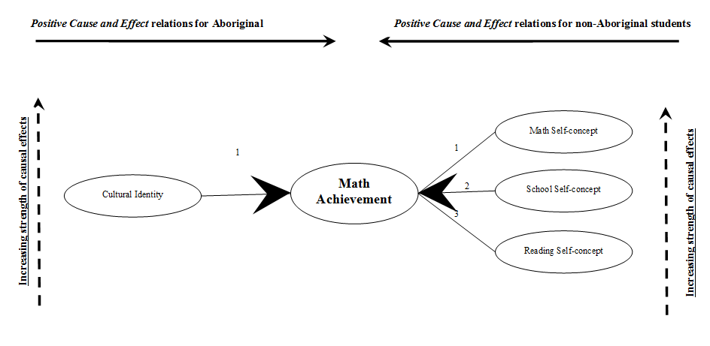
Causal Ordering for Math Achievement
Identifies significant causal effects in increasing levels of Math Achievement .
Only 1 variable had a causal impact for Aboriginal students, and 3 for the non-Aboriginal students.

Slide 34
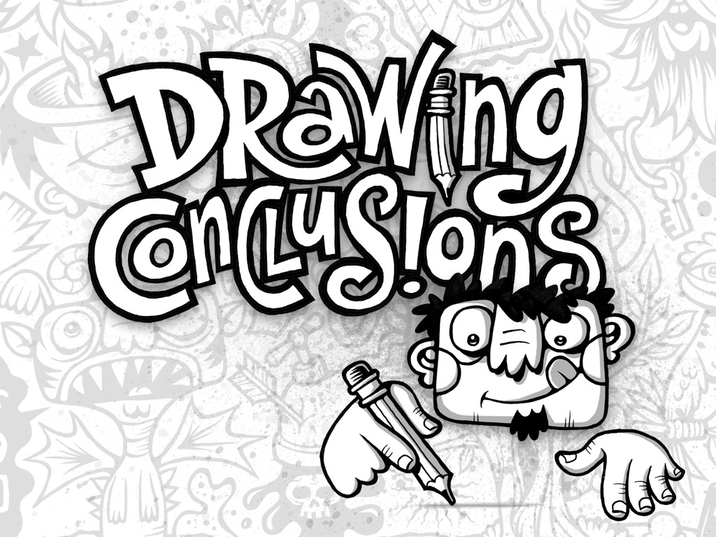
Summary
There are a wide diversity of factors contributing to the educational success of both Aboriginal and non-Aboriginal students
16 factors were identified that causally and positively influenced schooling outcomes for Aboriginal students
16 factors were also identified that causally and positively influenced schooling outcomes for non-Aboriginal students
However, the factors contributing to schooling success differed across the Aboriginal and non-Aboriginal samples

Slide 35
Implications and the Way Forward
Self Concept
  All facets of self-concept were found to be beneficial for seeding success in Aboriginal students. This finding extends on the international literature evidencing the benefits of promoting the academic self-concepts of non- Aboriginal students.
  Researchers have advocated the need to enhance the self-esteem of Aboriginal students, however, this research has demonstrated that it is critical the specific domains of self-concept (e.g. math, reading) should be targeted by intervention.
  In essence, no teacher is wasting their time in enhancing the self-concepts of Aboriginal students and this is likely to have a powerful causal influence on seeding success in related areas of achievement and performance.

Slide 36
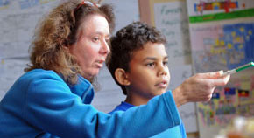
Implications and the Way Forward (cont.)
Teaching Strategies- Across the teaching strategies examined, five were found to be beneficial for Aboriginal students:
  Self-monitoring: There is a need for teachers to promote self-monitoring to allow students to directly link their progress to their achievement, and indirectly to their confidence
  Literacy scaffolding: It is recommended that all teachers ensure that each student is challenged with classroom reading tasks, regardless of their literacy levels. By acting as models for challenging learning tasks, teachers make success visible to all students, then building on this foundation, allow the dynamic nature of the whole class to discover further pathways to success.

Slide 37

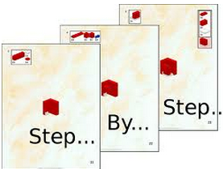
Implications and Ways Forward (cont.)
  Teaching Strategies (cont.)
  Questioning: Was found to increase Aboriginal students class participation and enjoyment of school, and decrease truancy. As this strategy has been positively related to higher-order learning, it is recommended that teachers incorporate this strategy into their teaching of Aboriginal students to promote critical thinking and avoid surface learning or memorisation approaches.
Clear Instruction: The findings suggest that to enhance Aboriginal students’ educational outcomes, teachers should provide clear explanations and guided learning strategies that involves making clear observable links between learning, assessment, and success.

Slide 38
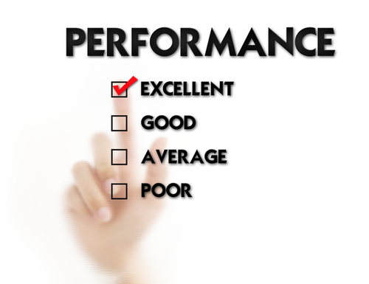
Implications and Ways Forward (cont.)
  Teaching Strategies (cont.)
  Performance feedback: was found to be a critical factor. Teachers need to ensure that Aboriginal students know what success is, as it allows students to relate their learning development to achievement and their sense of confidence. As advised by Hattie (2009) feedback should not about rewards, but about teachers giving information about tasks that reinforce the learner’s understandings, confidence, and self-evaluation.

Slide 39
Implications and Ways Forward (cont.)
  Cultural/Aboriginal Education Strategies- Four of these factors were found to be beneficial for the Aboriginal students:
  Aboriginal Community Involvement should be reinforced by teachers/schools by inviting respected members of the community into the classroom environment to act as mentors and share valuable knowledge to students in both traditional and contemporary contexts.
  By creating links to both the local community and knowledge’s, teachers would also become more welcoming to Aboriginal families, thus enhancing Teacher Family/Community relations where a stronger level of mutual respect is developed between teachers and those closest to the student learner, namely their family and immediate community

Slide 40
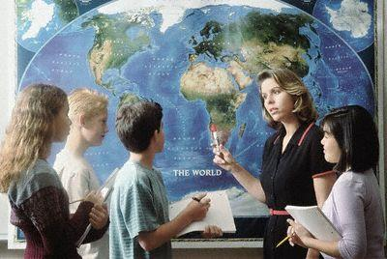
Implications and Ways Forward (cont.)
  Cultural/Aboriginal Education Strategies (cont.) -
  Cultural Sensitivity is closely related to increased cultural competency. It is important that teachers understand and respect the unique perspectives and needs of their students.
  4. Such understanding may be closely tied to the Strength of the Identity of both Aboriginal and non-Aboriginal students. It is essential that teachers ensure that the classroom is a safe environment for not only the culture of students, but also linking culture to learning within the schooling environment.
  5. In promoting cultural safety within the classroom, Cultural Diversity in learning is also strengthened, as students become aware of, and respectful, of the many cultures within Australia.

Slide 41

Implications and Ways Forward (cont.)
  Classroom Climate - Three of the strongest factors within the area of classroom climate were intrinsic to the positive relations between the students, their learning, and their teacher. They were:
  Making Learning Fun: Increasing the enjoyment of learning materials should be considered as a critical factor to engage both Aboriginal and non-Aboriginal students. Teachers should aim to make the learning process more enjoyable through engaging students with positivity and humour.
2. The findings suggest that if teachers remain positive and minimise individual criticism in the classroom, they will promote a greater level of Rapport with students, which is characterised by stronger levels of mutual trust and respect
3. Collaboration was also found to be a strong driver of student engagement, and emphasises that learning should be a shared experience across a classroom where the teacher also participates in the learning.

Slide 42
Next steps…
Focus on seeding success models rather than deficit models
Capitalising on advances in international theory, research, and measurement
Testing the psychometric properties of the instrumentation with Aboriginal populations
Undertaking causal modelling research with other age samples
Utilising a longer time lag between waves of administration
Employ mixed-methods approaches

Slide 43





Any Questions

Slide 44
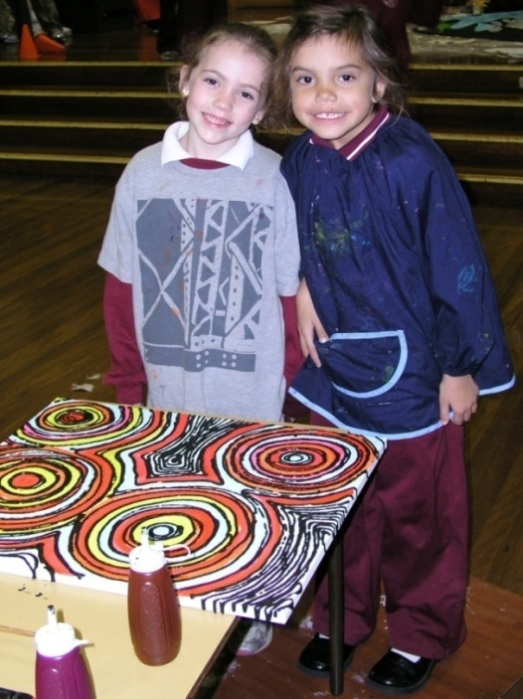
Cultivating Capability:
Explicating What Works for Gifted Aboriginal Primary and Secondary Students
Presenters:
Dr Anthony Dillon, Professor Janet Mooney,
Professor Rhonda Craven and Professor Alex Yeung
Institute for Positive Psychology and Education,
NSW Department of Education and Communities &
NSW Aboriginal Education Consultative Group Inc.
Institute for Positive Psychology and Education

Slide 45
Background
Recently in NSW, only 20 identified-as-gifted Aboriginal students were enrolled in opportunity classes (OCs) for 2011 (representing 1.21% of the NSW OC student population) while 45,184 Aboriginal students were enrolled in NSW public primary and high schools (representing 6.1% of the total NSW public school population).
Annually, many gifted Aboriginal students who are eligible to enter OCs and selective high schools (SHSs) decline to participate.
Due to the absence of evidence-based research in Australian gifted education, and gifted Aboriginal students in particular (Balchin et al., 2009), little is known about why gifted Aboriginal students are under-represented in OCs and SHSs, why other gifted Aboriginal students prefer mixed-ability, comprehensive settings, and what types of gifted programs attract and benefit different kinds of gifted Aboriginal students.
Institute for Positive Psychology and Education

Slide 46
Aims
The central purpose of this research project was to capitalise on cutting-edge interdisciplinary theory and research to explicate:
Underlying factors influencing the under-representation of gifted Aboriginal students in OCs and SHSs and the drivers of decision-making on whether or not to participate in OCs and SHSs;
Features of gifted education programs that attract and benefit gifted Aboriginal primary students; and
The extent to which gifted Aboriginal students’ perceptions about gifted education are similar and different to those of gifted non-Aboriginal peers.
Institute for Positive Psychology and Education

Slide 47
Research Questions
Four research questions were posed to address these aims. These focussed on multiple stakeholders’ perceptions of the:
Drivers of decision-making on whether or not gifted Aboriginal students apply to participate in OCs or SHSs;
Nature of the application process for placement in OCs or SHSs;
Drivers of decision-making on whether or not gifted Aboriginal students accept or decline the offer to participate in OC or SHS; and
Underlying factors that influence the under-representation of gifted Aboriginal students in OC/SHS.
Institute for Positive Psychology and Education

Slide 48
Participants
A total of 80 interviews were conducted with 20 students, 21 parents, 28 school staff, and 11 Aboriginal Community Liaison Officers (Table 1).
Table 1. Profile of Interviewees
 |  | Primary |  | Secondary |  | Identity
 |  | OC | Non-OC | SHS | Non-SHS | Aboriginal | Non-Aboriginal
Student (20) |  | 8 | 4 | 6 | 2 | 12 | 8
Parent (21) |  | 9 | 4 | 6 | 2 | 13 | 8
School staff | Principal (14) Teacher (14) | 7 | 4 | 1 | 2
 |  | 8 | 3 | 1 | 2
ACLO (11) |  | 4 | 4 | 2 | 1
Institute for Positive Psychology and Education

Slide 49

Research Question 1
What are the drivers of decision-making on whether or not gifted Aboriginal students apply to participate in OCs or SHSs?
Institute for Positive Psychology and Education

Slide 50
Results: Primary Decision Makers
Aboriginal students emphasised that they themselves made the decision to apply for OC/SHS. In contrast, non-Aboriginal students were more likely to report that their parents had a strong influence on their application for OC/SHS.
Parents, both Aboriginal and non-Aboriginal, seemed to perceive a balanced role of stakeholders in the decision to apply for placement. However, parents of Aboriginal students seemed to emphasise the role of the school more than parents of non-Aboriginal students.
Staff members from schools seemed to emphasise decision-making of both parents of Aboriginal and non-Aboriginal students.
Institute for Positive Psychology and Education

Slide 51
Results: Students’ Desire to Apply for Placement
The majority of Aboriginal (25/36) and non-Aboriginal stakeholders (29/44) identified student desire to apply a key driver of decision-making
I was just going to do it. I didn't really mind whether I got in or not (Non-Aboriginal Student 09).
Well, I wanted to see if I could get into that class because I was thinking that it would be really great to have a challenge to go to that school (Aboriginal Student 01).
Institute for Positive Psychology and Education

Slide 52
Results: Multiple Sources of Influence
My school recommended it at first, but then my Mum stepped in and said that she really wanted me to go there, because she thought that it would be a great opportunity (Aboriginal Student 07).
The choice was up to Jade if she wanted to. We gave her the option. Notes were sent home to apply for it, and I guess her teacher had a little bit of a part in it as well (Parent with Aboriginal child 03).
I think it is a collaborative approach where our students are seen from an Aboriginal point of view. I see our students achieving above the means and for x High School we've got two students at this high school and I think it's from the parent, the student, and the teacher - or the teachers they've got have put them up because they've seen the excellence in their work, their ethics, their leadership (ACLO 03).
Institute for Positive Psychology and Education

Slide 53
Results: Parental Encouragement
School staff (13 school staff and 3 ACLOs) suggested that a key driver of decision-making was parental encouragement to apply for an OC or SHS.
With parental encouragement, yes I think so. I mean sometimes students can be reluctant, but the leadership around the issues comes from parents generally (Principal 03).
I guess maybe parents … they think that they've [the students]got something extra that they have got to give that they're not going to get through mainstream or, I suppose, the normal day-to-day class or it could get them further, I guess, in their education or their achievements apart from the normal class. They might be pushed a bit harder (ACLO 11).
Institute for Positive Psychology and Education

Slide 54
Results: School Encouragement and Communication
In contrast to school staff’s perception of parents as the major source of influence, Aboriginal stakeholders’ reported that school staff (mainly teachers) primarily encouraged students to apply for OC or SHS.
Aboriginal stakeholders also emphasised that good communication with teachers was important as, due to the limited information communicated to parents, some parents of Aboriginal children did not receive the information.
Yeah, there was not really much advertising of the OC. It was just probably one letter and then if you missed that, you've missed everything...I talked to some parents about why they didn't let their kids apply to the OC class as well; they didn't know about it (Parent with Aboriginal child 17).
Institute for Positive Psychology and Education

Slide 55
Implications: Drivers of Decision-Making in Applying for OC/SHS Placement
These results suggest that:
To promote Aboriginal applications, information should target both Aboriginal students and parents to increase their awareness and understanding of the benefits of attending OCs and SHSs and the application process.
As most of the stakeholders mentioned a combination of influences for making a decision to apply for OC/SHS, Aboriginal students and their parents may benefit from: (1) greater encouragement from schools to apply; and (2) communication from schools to ensure that families are aware of the application process.
Institute for Positive Psychology and Education

Slide 56

Research Question 2
What is the nature of the application process for placement in OCs or SHSs, and how is it viewed by multiple stakeholders?
Institute for Positive Psychology and Education
Notes:
Research Question 2 asked about multiple stakeholders’ views of the nature of the application process for placement in OCs or SHSs and to what extent Aboriginal and non-Aboriginal perceptions are similar or different. While students and parents mainly expressed their opinions about the nature of the application process, school staff and ACLOs expressed their opinions on both the application process and the need for support in assisting parents of Aboriginal children with navigating the application process.
It is of grave concern that

Slide 57

Results: Knowledge of the Application Process
Some teachers and Aboriginal Community Liaison Officers were not aware of the process at all.
These findings imply that teachers and ACLOs could benefit from professional development in relation to the application process for OC and SHS entry.
Institute for Positive Psychology and Education
Notes:
Research Question 2 asked about multiple stakeholders’ views of the nature of the application process for placement in OCs or SHSs and to what extent Aboriginal and non-Aboriginal perceptions are similar or different. While students and parents mainly expressed their opinions about the nature of the application process, school staff and ACLOs expressed their opinions on both the application process and the need for support in assisting parents of Aboriginal children with navigating the application process.
It is of grave concern that

Slide 58

Results: Nature of the Application Process
Half of the total sample (40 of 80 interviewees) reported that the application process was straightforward.
The remaining interviewees (40) reported some concerns regarding the application process. The majority of these concerns were suggested by school staff or ACLOs.
It was pretty straightforward, I thought. Yes, just - I thought it was pretty - just fill out the form, send it off (Parent with Aboriginal child 03).
Institute for Positive Psychology and Education

Slide 59
Additional Support for Aboriginal Families
More than half of school staff (16/28) and the vast majority of ACLOs (10/11) emphasised that additional support would be beneficial for parents of Aboriginal students. They reported that many parents of Aboriginal children were not aware of the OC or SHS process and would experience difficulty completing the form.
- School staff and ACLOs also suggested that even when parents of Aboriginal students were aware of the application process they would need specific explanations and guidance on how to complete the forms.
I think it would vary between Aboriginal parents. Once again, there would be a proportion of Aboriginal parents where that process probably isn’t a great problem, but I would imagine - well I know - there are lots of parents that would need support to run through that process if that's what they wanted to do. They'd have trouble doing it independently (Principal 02).
Institute for Positive Psychology and Education

Slide 60

Few Online Applications
Interestingly, only 1 Aboriginal student, 3 parents of Aboriginal children, and 1 non-Aboriginal student reported applying on-line. School staff and ACLOs also raised the issue that many Aboriginal families did not have access to a computer or the internet.
Well, the majority of Koori families...don't have access at home to internet facilities. So there's a sort of decline in getting applications filled out in that sense (ACLO 05).
Institute for Positive Psychology and Education

Slide 61
Implications: Multiple Stakeholders’ Views of the Application Process
These results suggest that:
It seems vital to ensure that teachers and ACLOs are aware of the application process, to ensure information is effectively communicated to Aboriginal students and their parents.
More information needs to flow to families about the on-line process and that it may be helpful for schools to assist parents with access to the internet as well as make paper copies of the application available.
Better communication and awareness strategies about the application process for Aboriginal students and their parents may be useful.
Institute for Positive Psychology and Education

Slide 62

Research Question 3
What are the drivers of decision-making on whether or not gifted Aboriginal students accept or decline the offer to participate in OC or SHS?
Institute for Positive Psychology and Education

Slide 63
Accepting or Declining an OC/SHS Placement
Almost half of the Aboriginal students and the parents of Aboriginal children declined the offer for an OC or SHS placement. In contrast, no non-Aboriginal students or parents of non-Aboriginal children declined the offer.
Institute for Positive Psychology and Education
Notes:
It should be noted that this trend is not consistent with state-wide data and likely reflects the scope of the research, in that the focus was on Aboriginal students’ reasons for declining offers, and not that of non-Aboriginal students. DEC records indicate that on average, between 20% and 30% of students (both Aboriginal and non-Aboriginal) declined offers over the 2006 to 2011 period.

Slide 64
Drivers of Decision-Making in Regard to Accepting or Declining an OC/SHS Placement
Both Aboriginal and non-Aboriginal students were more likely to report that they were the ones to make the decision to either accept or decline the offer, as opposed to their parents making the decision.
Institute for Positive Psychology and Education

Slide 65
Implications of Drivers of Decision-Making in Regard to Accepting or Declining an OC/SHS Placement
These findings imply that it may be useful to:
Ensure that Aboriginal students are better educated about the benefits of OC/SHS settings.
Educate parents of Aboriginal students about the benefits of OC and SHS so that they are better positioned to assist their children make an informed decision.
Institute for Positive Psychology and Education

Slide 66
Rationale for Accepting an Offer
Most Aboriginal students and parents of Aboriginal children and their non-Aboriginal peers accepted the offer because of:
the stimulating educational environment offered; and
(2) the intellectual challenges and opportunities for students.
Aboriginal and non-Aboriginal students also emphasised the importance of making like-minded friends that were as intelligent as they were when accepting an offer.
Well first off it’s a selective high school so you get to learn a lot more and challenge yourself mentally because most high schools only do the basic stuff but x does the excelled programs (Aboriginal Student 07).
Institute for Positive Psychology and Education

Slide 67
Rationale for Accepting an Offer (cont.)
School staff and ACLOs also suggested that the supportive school environment fostered higher academic achievement and echoed that the selective setting enabled students to be with like-minded peers.
A couple of good reasons is that children want to be with likeminded students or with students who are operating at a particular kind of academic level and that that sense of belonging to a group of children who are performing and thinking at a fairly different level to a lot of mainstream students, being in that cohesive, that homogenous or that kind of group, where they can find friends that they can communicate with (Teacher 14).
Institute for Positive Psychology and Education

Slide 68
Rationale for Aboriginal Students Declining an Offer
High intellectual requirements of the OC/SHS environment would preclude them from participating in other non-academic interests;
They wanted to be involved in a particular school program (e.g., sports or music program), which they did not feel would be available in OC or SHS settings;
Reluctant to leave their friends;
The need to travel long distances to attend the selective setting; and
Some use the offer to negotiate a scholarship into a private school.
He had a talk to some kids that he knew who were there and decided that he didn't want to go because it didn't offer other stuff and that it was too academic. So he didn't want to be just studying. He wanted to be doing other things at school too, like his sport - he's quite involved in drama and stuff like that too. He just felt there wasn't enough of that on offer - that it was too academic for him. So he chose not to go for those reasons (Parent with Aboriginal child 11).
Institute for Positive Psychology and Education

Slide 69
Implications: Drivers of Decision-Making in Regard to Accepting or Declining an OC/SHS Placement
These results suggest that:
Given the under-representation of Aboriginal students in selective settings and that some eligible Aboriginal students decline their offers, it seems important to develop strategies to address the reasons for the decline of offers.
It is worthwhile considering the establishment of virtual selective environments to enable more access to a selective setting for Aboriginal students. Providing more access to OCs and SHSs in rural areas may also be worth considering, while e-friend/buddy networks for Aboriginal students in OCs or SHSs may make these settings more attractive.
Institute for Positive Psychology and Education

Slide 70

Research Question 4
What Factors Influence the Under-representation of Gifted Aboriginal Students in OC/SHS?
Institute for Positive Psychology and Education

Slide 71
Results: The Need to Provide Aboriginal Families With More Information
All participants stressed that there was an urgent need to effectively provide parents of Aboriginal students and Aboriginal students with more information in general about the advantages of selective settings and more actively publicise the application process.
There's just not enough information out there to the community. Nobody actually knows what an OC class is… We had community thinking it was a class designed for troubled kids and we were bussing them in. Until they actually understood that the OC class is actually for gifted, intelligent students and you have to actually apply in order to get in there, then they understood. But see community don't know anything about selective schools or OC classes, because there's nothing out there. And the schools don't put anything out there to let the community know, let the parents know (ACLO 04).
Institute for Positive Psychology and Education

Slide 72
Results: Reluctance of School Staff to Promote Selective Settings
Some parents of Aboriginal children also noted that there was a reluctance by some school staff to publicise the opportunity to apply for a selective setting as this could result in the school losing teachers.
School staff also noted that there may be a reluctance to promote selective settings as the schools do not wish to lose their best students.
It's such a small, small school. You should think that the message would be out there and it's just not out there at all… this principal didn't want to lose another child. If he lost more children, he was going to lose more classrooms, so obviously he's upset because he's losing another child (Parent of Aboriginal child 16).
Institute for Positive Psychology and Education

Slide 73
Teaching the Teachers
Data suggested that teacher education could be enhanced to ensure that teachers are aware of the benefits of selective settings and the application process
Participants also suggested that it would be useful for teachers to be trained on understanding Aboriginal culture and how to identify gifted Aboriginal students
Some staff also suggested that gifted Aboriginal students needed to be identified at an earlier point and their parents informed about placement well ahead of the application period to allow them access to information to make an informed decision
Institute for Positive Psychology and Education

Slide 74
Results: Learning More About Aboriginal Australia
Some stakeholders suggested that it was important for all school staff and students to know more about Aboriginal Australia to address misconceptions about the capabilities of Aboriginal students so that more Aboriginal students are identified and encouraged to apply for selective placement
ACLOs also suggested that incorporating more Aboriginal perspectives into the curriculum in selective schools may attract Aboriginal students
Institute for Positive Psychology and Education

Slide 75
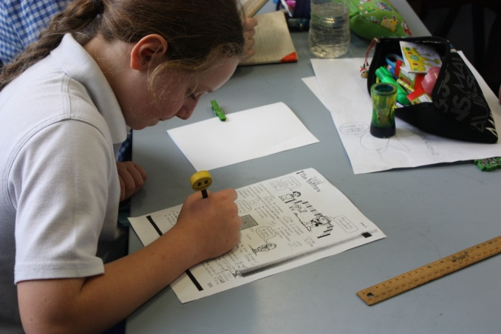
Enhancing Aboriginal Students’ Academic Self-concepts
Participants emphasised that many Aboriginal students did not feel their academic abilities were good enough to warrant an OC/SHS placement and there was a need to enhance Aboriginal students’ academic self-concepts.
I would say, just go for it. You know, you never know until you have a try, and you know, really, you don't really know what a child is capable of unless they actually sit down and attempt something. So, and keep their spirits up. Like, always motivate them to do good; praise them, and they will. They'll want to do better with lots of praise (Parent of Aboriginal child 03).
Institute for Positive Psychology and Education

Slide 76
Access to First Hand Information
- School staff also suggested that there was a need to provide Aboriginal students and parents with first-hand information about the benefits of selective settings.
I think bridging that gap between school community and the parents at home, so having perhaps community members and things employed, or a transition program or something where families can come in… offering it to perhaps all students and things like that so they can see what it's like and experience it and then their peers and things can see what a great thing it is that they're achieving, and also breaking down those barriers of unknown and things like that (Teacher 06).
Institute for Positive Psychology and Education

Slide 77
Implications: Factors Influencing the Under-representation of Gifted Aboriginal Students in OC/SHS
The results suggest that:
Selective settings could attract more Aboriginal students if they publicised their Aboriginal perspectives.
Teacher education could also be enhanced to ensure pre-service teachers are knowledgeable about Aboriginal culture and Aboriginal giftedness, and how to identify gifted Aboriginal students.
As research evidence demonstrates the importance of academic self-concept and its relation to beneficial educational outcomes, including achievement, enhancing Aboriginal students’ academic self-concepts may be a vital avenue to pursue to encourage more Aboriginal students to apply for selective placement.
Institute for Positive Psychology and Education

Slide 78
Summary and Recommendations Regarding the Decision- Making Process for Gifted Aboriginal Students
- To encourage GAT Aboriginal students who may benefit from selective settings to apply:
Professional teacher development could focus on ensuring that pre-service teachers, and in-service teachers, are knowledgeable about Aboriginal culture and Aboriginal giftedness, and how to identify gifted Aboriginal students
(2) More information about the application process and the advantages of attending OCs and SHSs could be provided to teachers and ACLOs as well as about the benefits of comprehensive settings to help inform Aboriginal students and their parents decision-making
(3) DEC could consider strategies to promote selective opportunities to principals, teachers, and the families of Aboriginal student
Institute for Positive Psychology and Education
Notes:
In providing these insights it should be remembered that the sample interviewed was small and qualitative methods were used. While the sample included a mix of city and rural stakeholders, generalising to the total population of Aboriginal students is problematic given their diverse heterogeneous make-up. However, the current findings are useful for identifying some preliminary directions to address barriers to Aboriginal students applying for and taking up gifted education and to inform the way ahead for future research.

Slide 79
Summary and Recommendations Regarding the Decision Making Process for Gifted Aboriginal Students (cont.)
(4) DEC could consider ways to effectively communicate how to apply for OC and SHS placement to all stakeholders
(5) Selective settings could promote a balanced, culturally sensitive curriculum and the nature of their Aboriginal Education program
(6) ‘Virtual’ selective settings would allow Aboriginal students to remain in their own home schools with their friends but still glean the benefits of a selective setting (e.g., an innovative program that value-added to the school curriculum and enables students to flourish). The development and evaluation of virtual selective settings is another avenue that could be considered by the DEC to promote the uptake of OC and SHS places by Aboriginal students.
Institute for Positive Psychology and Education

Slide 80
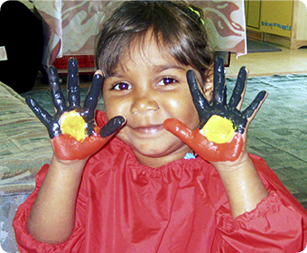
Potential Ways Forward: Proposed ARC Linkage Grant
Cultivating Koori Kids Capability:
Who Benefits Most From Different Types of Educational Settings?
Institute for Positive Psychology and Education

Slide 81
A Significant Australian Educational Issue of Our Time
Current gifted students are expected to provide future leaders in all fields and justify claims that Australia is the "clever" country.
The appropriate education of gifted students can be argued on the basis of "excellence and equity" issues, of enriching the intellectual climate and strengthening the socio-economic fabric of Australia, and of the cultivation of talent in all facets of Australian society.
However, in Australia the capacity of gifted Aboriginal students is yet to be fully realised (see Balchin, Bymer, & Matthews, 2009 for an overview) and Craven (2011) has lamented the sheer wastage of Aboriginal talent and emphasised the need to grow and harness Aboriginal students’ full potential.
Little is also known about which educational settings (selective, school-based GAT, mixed ability) best suit what types of Aboriginal students.
Institute for Positive Psychology and Education

Slide 82
Purpose
This proposed project will capitalise on cutting-edge interdisciplinary and multi-method research, a powerful multi-occasion multi-cohort experimental design, and state-of-the-art statistical analyses to:
Identify what types of Aboriginal students benefit most from different types of educational settings (selective, school-based GAT class, mixed ability);
Empirically test the impact of strategies designed to communicate to high ability Aboriginal students and their parents the benefits of different types of educational settings to enable informed decision-making; and
(3) Critically evaluate the impact of virtual hub innovative environments in mathematics and English that are developed by a hub of leading teachers from groups of participating schools to meet the needs of high ability students and local communities and enrich schooling for high ability Year 5 and 6 Aboriginal and non-Aboriginal primary students and cultivate capability to result in high ability students flourishing in their chosen schooling environment.
Institute for Positive Psychology and Education

Slide 83
Three Studies
In three synergistic studies, we propose to capitalise on results from our successful partnership with the DEC to:
Ascertain the benefits of different types of educational settings for different types of Aboriginal students;
Communicate the benefits of different types of settings to gifted Aboriginal students and their parents and comprehensively test the effects of these strategies in helping Aboriginal students and their parents to make an informed decision on schooling choice; and
Critically evaluate the psychosocial and educational impacts of virtual hub innovative environments in mathematics and English on a broad array of constructs to identify possible tangible benefits that can be utilised to ensure that the mental health, well-being, and academic functioning of both Aboriginal and non-Aboriginal high ability primary students are optimised.
Institute for Positive Psychology and Education

