Slide 1
LEAP conference

Slide 2
2009 800 meta-analyses
2016 1200+ meta-analyses
  ¼ billion students
  From the student, home, school, curriculum, teacher, strategies …

Slide 6
Rank | Influence | Effect-size
151 | Divorced or remarriage | .20
157 | Personality relations | .18
167 | Adopted children | .16
173 | Diet | .12
174 | Gender (males-females) | .12
176 | Diversity of students in the class | .11
181 | Sleep | .07
189 | Parental employment | .03
191 | Sleep | .01
196 | Diabetes | -.17
200 | Not Labeling students | -.61
Not the attributes of students d = .08

Slide 7
Rank | Influence | Effect-size
140 | Summer school | .23
141 | Finances | .23
142 | Religious Schools | .23
147 | Class size | .21
159 | Within class grouping | .18
171 | Ability grouping | .12
177 | Distance Education | .11
179 | Changing school calendars/timetables | .09
180 | DeTracking | .09
181 | Single sex schools | .08
183 | Charter Schools | .07
185 | Diversity of students | .05
187 | Multi-grade/age classes | .04
192 | Open vs. Traditional | .01
194 | Welfare Policies | -.12
195 | Retention (hold back a year) | -.13
Not the structure of schools or classes d=.10

Slide 8
Rank | Influence | Effect-size
146 | Teacher verbal ability | .22
156 | Co-/ Team teaching | .19
170 | Mentoring | .15
175 | Teacher education | .12
178 | Teacher subject matter knowledge | .09
189 | Volunteers/Teacher Aides | .03
Not who the teachers are d=.13

Slide 9
Rank | Influence | Effect-size
79 | Intelligent tutoring systems | .43
117 | CAI in mathematics | .30
138 | CAI in Science | .23
148 | CAI in small groups | .21
158 | CAI in distance education | .18
163 | Web based learning | .18
Not the technology (yet) d=.26
Not the technology (yet) d=.26

Slide 10

When teachers SEE learning through the eyes of the student
& when students SEE themselves as their own teachers

Slide 11
Teachers, working together, as evaluators of their impact .93
The power of moving towards explicit success criteria .77
Errors and trust are welcomed as opportunities to learn .72
4. Maximize feedback to teachers about their impact .72
5. The right proportion of surface to deep in lessons .71
The Goldilocks principles of challenge, & deliberate practice
to attain these challenges .60

Slide 12

Notes:
Three key messages:
1. Social change is

Slide 13
Teacher expertise
School Leader expertise
Teacher education expertise
Professional learning expertise

Slide 14


Slide 15
INFLUENCE | ES | Rank
Iodine deficiency | -0.49 | 198
Depression | -0.42 | 197
Corporal punishment in the home | -0.33 | 195
Parental employment | 0.03 | 186
Types of testing | 0.06 | 182
Sleep | 0.07 | 181
Single sex schools | 0.08 | 179
Detracking | 0.09 | 177
Adopted children | 0.16 | 163
Divorced or remarriage | 0.25 | 133
Use of powerpoint | 0.26 | 131

Slide 16
INFLUENCE | ES | Rank
Iodine deficiency | -0.49 | 198
Depression | -0.42 | 197
Corporal punishment in the home | -0.33 | 195
Parental employment | 0.03 | 186
Types of testing | 0.06 | 182
Sleep | 0.07 | 181
Single sex schools | 0.08 | 179
Detracking | 0.09 | 177
Adopted children | 0.16 | 163
Divorced or remarriage | 0.25 | 133
Use of powerpoint | 0.26 | 131

Slide 17
INFLUENCE | ES | Rank
Collaborative learning | 0.29 | 119
Mobile phones | 0.29 | 119
Online, digital tools | 0.30 | 114
Music based programs | 0.37 | 93
Philosophy in schools | 0.43 | 79
Intelligent tutoring systems | 0.43 | 79
Relative age within a class | 0.45 | 66
Student increased investment in learning | 0.48 | 64

Slide 18
INFLUENCE | ES | Rank
Collective teacher efficacy | 1.57 | 1
Conceptual change programs | 1.16 | 5
Cognitive task analysis | 0.87 | 9
Service learning | 0.58 | 35
Pre school with at risk students | 0.56 | 39
Scaffolding | 0.53 | 48

Slide 19
Belief of one’s own ability to promote positive change for students
Teacher Efficacy
Beliefs of teacher group about collective ability to promote successful student outcomes within their school
Collective Teacher
Efficacy
Notes:
Collective Teacher Efficacy is an emergent group level property referring to “the perceptions of teachers in a school that the faculty as a whole will have a positive effect on the students” (Goddard, Hoy, & Woolfolk Hoy, 2000).

Slide 20

I Collaborate
)

Slide 21
Teachers collective efficacy refers to “the judgements of teachers in a school that the faculty as a whole can organize and execute the courses of action required to have a positive effect on students”
Goodard, Hoy & Woolfolk-Hoy, 2004

Slide 22
Five sources of efficacy
Mastery experiences - attributing success to teachers
Vicarious experiences – see success in schools like their own
Persuaded by credible and trustworthy persuaders
Affective status – feelings of excitement and satisfaction
Subjective norms – beliefs that in this school we cause learning

Slide 23
Teachers Collective Efficacy relates to …
Evaluating current impact
Seeing impact is a function of teaching & working together
Conveying high expectations
Decreasing disruptive behaviour
Educating parents about learning
Responsiveness to leadership
Monitoring impact
Helping teams get and interpret feedback

Slide 24
Coplan
Co-evaluate
Co-analyse
Co-Reflect

Slide 25

Know thy impact
Evaluation capacity
building
Progress to Achievement

Slide 26
A school mission re impact
All students are at Level 2 Naplan by Year 3

Slide 27
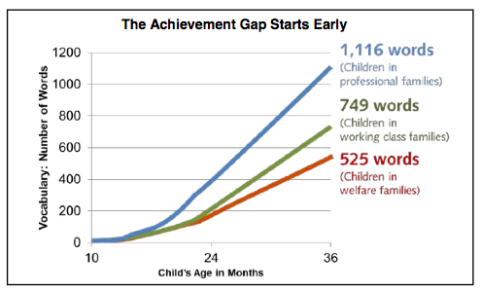


Slide 28
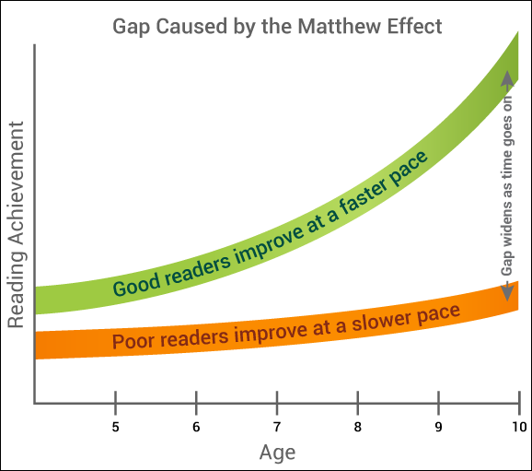

Slide 29
Growth and SES
Reading r = -.58
Growth r = .11

Slide 31
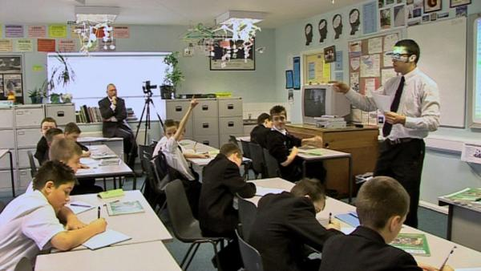

Slide 32
Classroom observation –
Watch the impact not the teacher!

Slide 33


Imagine
You had an accurate record of every lesson to reflect on what you actually said in the classroom.
The process of teaching and learning was something you could touch, look at and reflect upon – a mirror
You received real feedback about how you’re progressing as a teacher in a non-punitive way.
You can see learning through the eyes of the students
You do not need to have a video or person in the room recording and observing

Slide 34
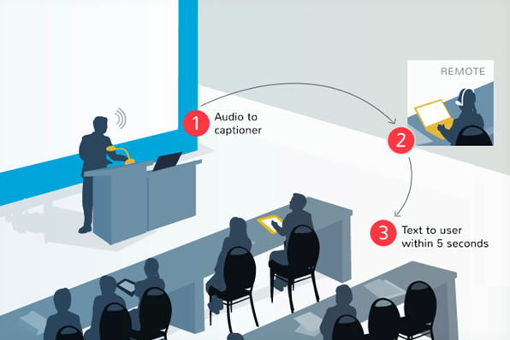
Real-time
captioning

Slide 35
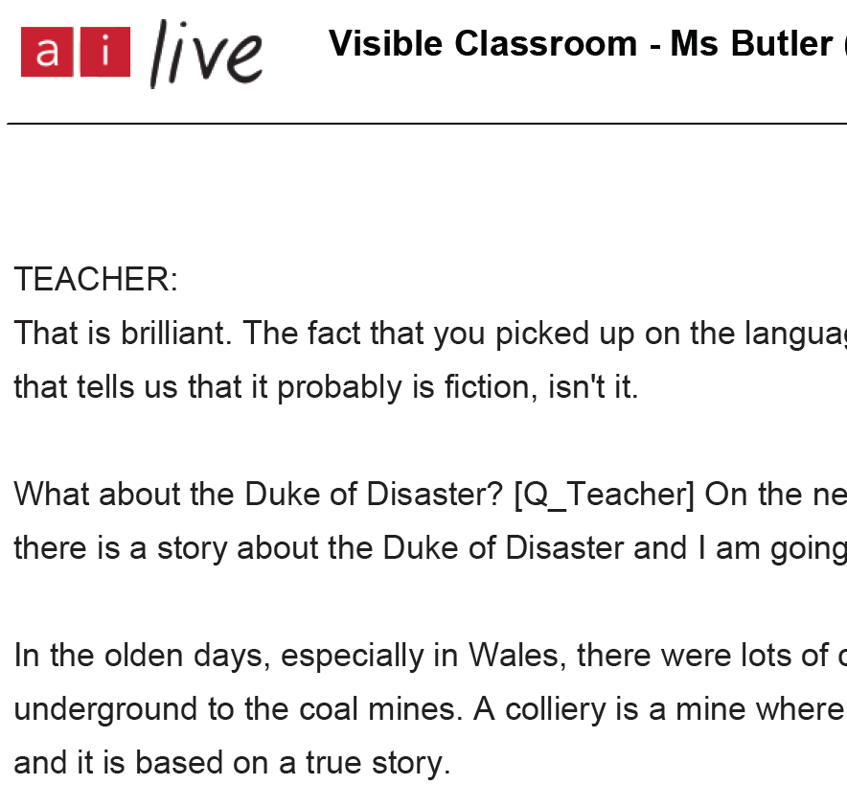
Transcripts
Teachers received a transcript at the end of their lesson.
Students
delivered on tablets within 5 seconds
99%+ accurate
interaction with transcript
utilize at later date

Slide 36
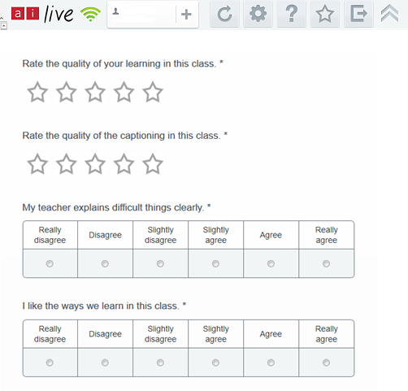
Student Feedback on their Learning

Slide 37



Coding transcripts
Deepen understanding
Connect ideas
Scaffolded activities
Collaborate
Connections
Divergent
Convergent
Repeats comment
Positive classroom environment
Review
Behaviour
Prompting
Instructions
Summarize
Feedback
Resources
Important
Introduces & explains
Goals
Positive classroom environment
The Rubric
Promoting Critical
Analysis
Engage &
Understand
Feedback
& Goals
Notes:
Deep feedback: A vehicle for change
Analysed over time
Effective teaching rubric
Evaluation & deep feedback
What next?
The individual feedback reports provided an overview of the goals of participants, commentary on individual teaching practice, as well as a comparison with the average findings of the other teachers involved in the pilot. This gave teachers the opportunity to look not only at their own practice, but to understand what other teachers were doing in their own classrooms- facilitating information sharing?.
The items of the rubric were broken into subheadings relevant to the categories under which they fell. The report was also reader-friendly, incorporating data visualisation techniques to ensure that the data was presented in simple graphs for ease of understanding.
The feedback documents also included data from student surveys that were conducted at the end of each lesson as to student satisfaction with the teaching and learning. Finally, resources that can support teachers, and a detailed explanation of the dashboard, were provided. Although reports were individualised, teachers were encouraged to share their documents with their peers and evaluate both the program and the findings on a collaborative basis.

Slide 38
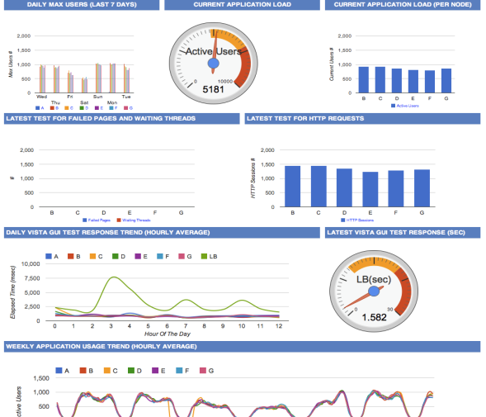
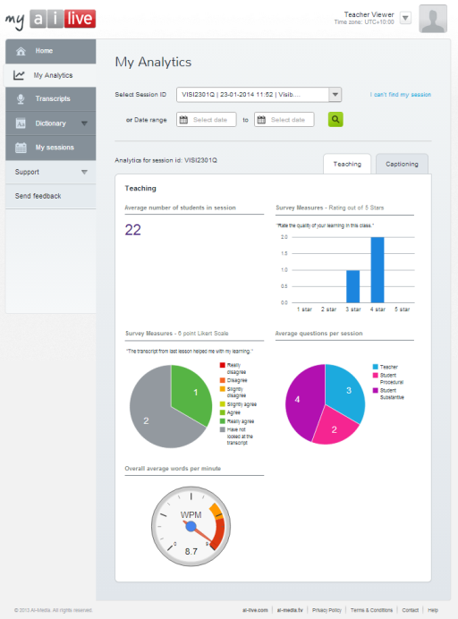
Learning Analytics

Slide 39


Slide 40
Factors we WANT to go forwards | ES
Provides immediate, specific and corrective feedback | .41
Provides student with opportunity to deepen understanding, | .39
Sets clear behaviour expectations | .37
Students have opportunity to ask task-related questions | .31
Emphasises important points | .31
Concludes the lesson by recapitulating/summarising key points | .31
Factors we WANT to go backwards
Repeats comment or question from student before answering | -.27
Asks closed questions or questions which have one correct answer | -.44
Provides step by step instructions on completing tasks/activities | -.47
Introduces and explains new/complicated vocabulary, | -.47
Add in effect sizes

Slide 41





Thank you
Just out
August 8th
Just out
September
October

