Slide 1

Building teachers’ collaborative efficacy
Notes:
This is the title slide for session one.

Slide 2
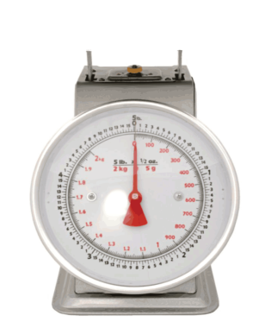
The effect size common scale
0
Decreased
Zero
Enhanced
Notes:
Some things we do make student achievement actually go backwards. At zero are the things that have no effect on student achievement. From zero (orange) to blue is where we need to focus our energies. What are the things we can do that will have the biggest effect on student achievement?
We will show you how to calculate an effect size later in the session. In the meantime, what you need to know is that calculating an effect size is easy. You are doing a mathematical operation across two sets of data from the same students – comparing one set of results with another.
To help you conceptualise this, an effect size of one is equivalent to two to three years of growth.

Slide 3

The typical influence on achievement
So what is the typical effect across
1400+ meta-analyses
80,000+ studies
¼ billion students
Notes:
The evidence was collected from existing meta-analyses – the actual research that is the basis of the meta-analyses included published material and quality-assured research papers and student projects (e.g. unpublished PhD theses). John Hattie is constantly updating the meta-analyses, so you may find slight variations in the effects across publications. The material in this workshop will be kept up to date and the effect size tables in the workbook will be accurate at the time of printing.
Meta-analyses
In statistics, meta-analyses combine the results of several studies that address a set of related research theories. The results are often combined as an effect size. Meta-analyses are often important components of a systematic review procedure. For example, a researcher might gather together all the studies they can find on a topic, for example, homework and report on the findings across the projects. John Hattie has taken this a step further, and his research is meta-analyses of meta-analyses. He took over 900,000 meta-analyses and combined this data together. It is like the huge ‘sucking up’ of existing research – the ‘mother of all research projects’.

Slide 4
Distribution of effects
Hinge point d = .40
Notes:
This is the distribution of the effects. You can see from the numbers where the zero point is, so from yellow up to blue is everything over 0 – from here, we have a positive influence on achievement. And it is quite clear to see how we get the figure of 95% of what we do having a positive effect on achievement – and the reason why we should set the bar high – at least 0.40 effect size.¹
Key points
This is the normal distribution.
Almost everything works.
Setting the bar at zero is too low.
Set the bar at 0.40 – the average effect size.
Variance is important – the typical effect size may not be uniform across all students.
These effects actually come from all of the individual studies which is the reason why some of the numbers are higher than the overall lowest and highest effect sizes on the published list.

Slide 7

Teacher and school leader expertise
Teachers & students, working together, as evaluators of their impact .90
All having high expectations .90
All moving towards explicit success criteria .77
4. Using the Goldilocks principles of challenge .74
5. Errors and trust are welcomed as opportunities to learn .72
6. Maximize feedback to teachers about their impact .72
7. A focus on learning: The right proportions of surface to deep .69

Slide 8

When teachers SEE learning through the eyes of the student
Visible Teaching – Visible Learning
and when students SEE themselves as their own teachers.
Notes:
This is our summary slide and it pulls together all of the messages from today.
Teachers must see learning from the point of view of the student. That is the only way they will know if they are being effective and having an impact on student learning.
When students are actively engaged in learning in ways that are metacognitive, collaborative and self-regulated then they will be successful. It is only through us providing the environment and systems for this to happen that it can be possible.
Ask participants now to turn to page 64 to complete the reflections for the day.

Slide 9
INFLUENCE |  |  | INFLUENCE
Collective teacher efficacy |  |  | Clickers
Cognitive task analysis |  |  | One on one laptops
Jigsaw method |  |  | Mentoring
Deliberate practice |  |  | Charter Schools
Summarization |  |  | School calendars/timetables
Rehearsal and memorization |  |  | Performance pay
Outlining and transforming |  |  | Breastfeeding
Self-verbalization & Self-questioning |  |  | Presence of Humor
Underling and Highlighting |  |  | Immigrant status
Relative age in class |  |  | Sleep
Philosophy in schools |  |  | Not liked in class
Mobile phones |  |  | Suspension/ Expelling students
Chess |  |  | Corporal punishment in the home
Mindfulness programs |  |  | Depression
Grit/ Growth |  |  | Boredom

Slide 10
INFLUENCE | ES | RANK | INFLUENCE | ES | RANK
Collective teacher efficacy | 1.57 | 1 | Clickers | 0.22 | 189
Cognitive task analysis | 1.29 | 5 | One on one laptops | 0.16 | 206
Jigsaw method | 1.20 | 7 | Mentoring | 0.12 | 212
Deliberate practice | 0.79 | 18 | Charter Schools | 0.09 | 221
Summarization | 0.79 | 19 | School calendars/timetables | 0.09 | 222
Rehearsal and memorization | 0.73 | 29 | Performance pay | 0.05 | 231
Outlining and transforming | 0.66 | 39 | Breastfeeding | 0.04 | 232
Self-verbalization & Self-questioning | 0.55 | 64 | Presence of Humor | 0.04 | 233
Underling and Highlighting | 0.50 | 83 | Immigrant status | 0.01 | 236
Relative age in class | 0.45 | 107 | Sleep | -0.05 | 240
Philosophy in schools | 0.43 | 110 | Not liked in class | -0.19 | 245
Mobile phones | 0.35 | 134 | Suspension/ Expelling students | -0.20 | 246
Chess | 0.34 | 141 | Corporal punishment in the home | -0.33 | 249
Mindfulness programs | 0.29 | 160 | Depression | -0.36 | 251
Grit/ Growth | 0.25 | 180 | Boredom | -0.49 | 252

Slide 11
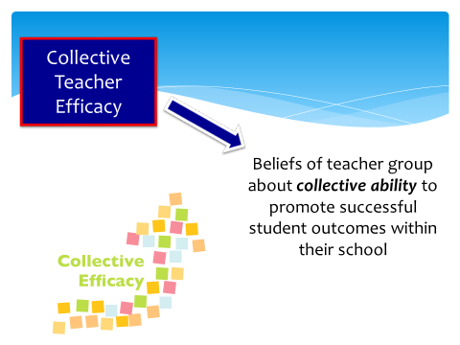

I collaborate
New #1
d= 1.57

Slide 12
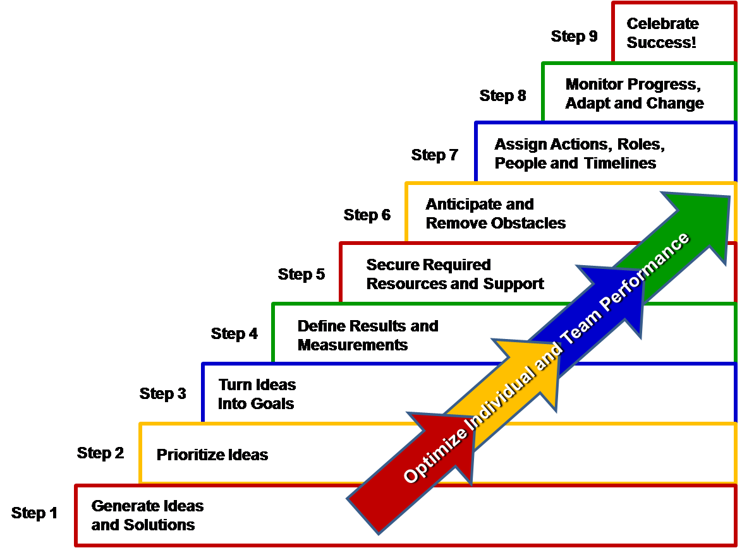
School Leaders
Working together
Teachers are to DIE for
Outcomes of CE
Collective motivators
The “I” & “We” skills
Evaluative thinking
Role of expectations
What is efficacy

Slide 13


1
1. The power of efficacy
  I cause learning

Slide 14


The role of expectations
2
 | No studies | d | Rank
Student expectations | 250 | 1.33 | 3rd
Teacher expectations | 674 | 0.43 | 108th
I strive for challenge and not ‘doing your best’
I explicitly inform students what successful impact looks like from the outset

Slide 15

I am an evaluator
of my impact
3
Evaluation capacity
building
Know thy Impact

Slide 16

Evaluative
thinking
Using GPA, TCAT, Demographic variables in predicting CWA

Slide 17
Evaluative Thinking
Diagnostician - Build climate of trust, errors, questions, problem solving:
Problem Solver- The thinker in the classroom
Leader of Learning - The deep knowledge of learning and the learner
Collaborator - Knowing how to work in a team: The enactment in the classroom
Clinical Practitioner - Knowing interventions; Assessment as feedback to the teachers; Teachers are to DIiE for

Slide 18

4
The “I” and “We” skills
The “I” skills
Is Self-Aware
Is a Learner
Can manage conflict through collaborative sense making
Demonstrates Social Sensitivity
The “We” skills
Collective Efficacy
Shared purpose to improve
Problem Solving
Trust
Strength Based

Slide 19

5
Collective motivators
Mastery experiences - attributing success to teachers
See success in schools like their own
Persuaded by credible and trustworthy persuaders
Feelings of excitement and satisfaction
Subjective norms
Feeding the expectations

Slide 20

Teacher dialogue dwells on overwhelming challenges:
Undermines sense of efficacy
Normalizing
New Teachers
Pecking Orders
Professionally Challenging Peers
Teachers work together to address student learning, motivation, etc.: Significantly Increases efficacy
Notes:
TETER-Totter: Tschannen-Moran et al. (1998) recognized the contagiousness of a low sense of efficacy in schools and the resultant demoralization.
Schools where teachers’ conversations dwell on the insurmountable difficulties of educating students are likely to undermine teachers’ sense of efficacy. Schools where teachers work together to find ways to address the learning, motivation, and behavior problems of their students are likely to enhance teachers’ feelings of efficacy (p 221).

Slide 21

Agree on outcomes of Collective Efficacy
6

Slide 22

I feel I belong
Will and Thrill of learning
Achievement and progress
Respect for self and Respect for others
Mind frames of the teachers & students
Class and school as safe and fair place to explore ideas
Intended and unintended changes from teacher practice
School as inviting place to want to come and learn (attendance)

Slide 23
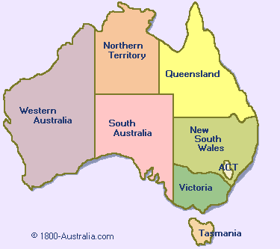
State ranking in Australia

Slide 24
1st 2nd 4th 3rd 8th 5th 6th 7th

Slide 25
1st 2nd 4th 3rd 8th 5th 6th 7th
8th 7th 6th 5th 4th 3rd 2nd 1st

Slide 26
Over time 2008-2017

Slide 27
Northern Territory 2008-2017

Slide 28
Growth comparisons
Males and female growth similar 0.05
LOTE higher than non-LOTE 0.13
Indigenous growth similar 0.04
Lower parental occupation higher
growth than upper 0.11

Slide 29
High vs. Low Growth Schools
Lowest Growth Schools Highest Growth Schools
Reading Writing Numeracy Reading Writing Numeracy
School Growth Growth Growth Growth Growth Growth
H -.14 -.17 .13 312 H .53 .48 .76
M .83 -1.88 -.02 313 L .73 .40 .64
H -.06 -1.31 .61 314 M .60 .72 .48
L .17 -.18 .08 315 H .68 .59 .61
L .54 -.63 .47 316 M .76 .48 .67
L .10 .24 .23 317 H .73 .61 .64
M .21 .08 .30 318 L .68 .81 .57
M .35 .02 .24 319 M .66 .74 .71
H .41 -.25 .46 320 H .94 .72 .83
H .08 .29 .30 321 L .50 .88 .47

Slide 30
Focus on progress to achievement
High Proficiency/ Achievement
Low Proficiency/ Achievement
 | Low Progress/ Growth |  |  |  |  | High Progress/ Growth
> 1 year’s growth

Slide 31
Progress to Proficiency
High Proficiency/ Achievement
Low Proficiency/ Achievement
 | Low Progress/ Growth |  |  |  |  | High Progress/ Growth
Cruising schools/
students
> 1 year’s growth
Optimal schools/ students
Unsatisfactory schools/ students
Growth schools/ students

Slide 32
Progress to Proficiency
High Proficiency/ Achievement
Low Proficiency/ Achievement
 | Low Progress/ Growth |  |  |  |  | High Progress/ Growth
Cruising schools/
students
> 1 year’s growth
Optimal schools/ students
Unsatisfactory schools/ students
Growth schools/ students

Slide 33
Progress to Proficiency
High Proficiency/ Achievement
Low Proficiency/ Achievement
 | Low Progress/ Growth |  |  |  |  | High Progress/ Growth
Cruising schools/
students
> 1 year’s growth
Optimal schools/ students
Unsatisfactory schools/ students
Growth schools/ students

Slide 34
Australia Years 7-9 Reading
ACHIEVEMENT
GROWTH

Slide 35
Reading Yr 5 2011-2017

Slide 36
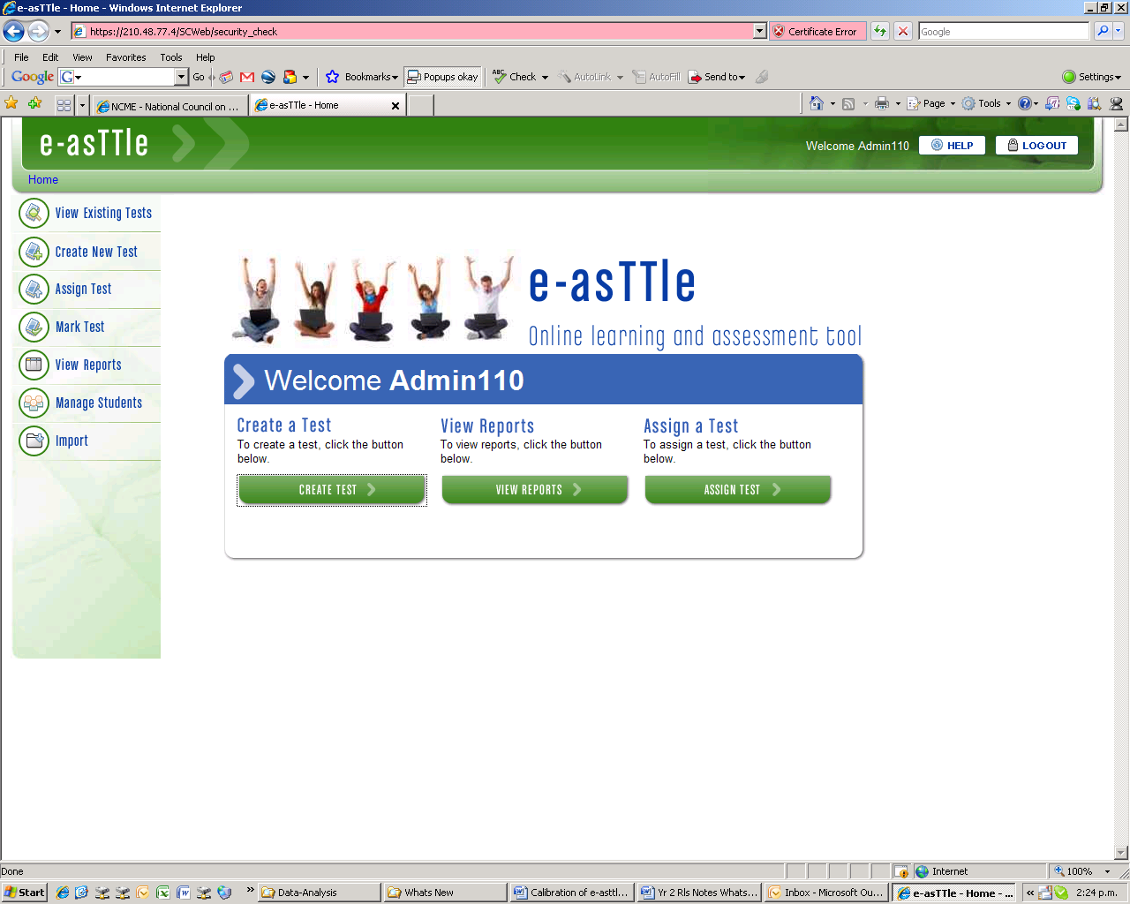
Welcome screen for Teachers
Notes:
36

Slide 37
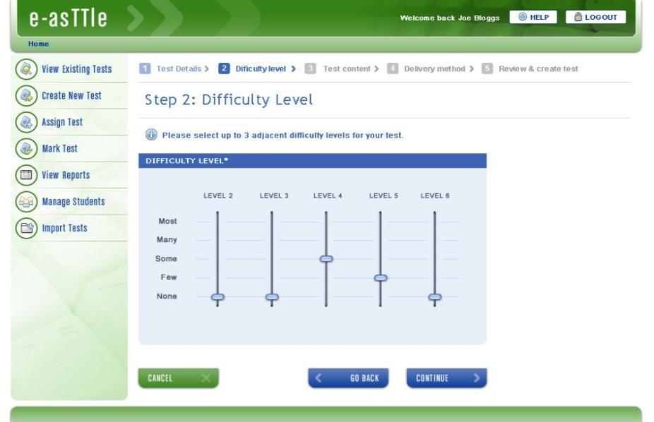
Choose difficulty

Slide 38
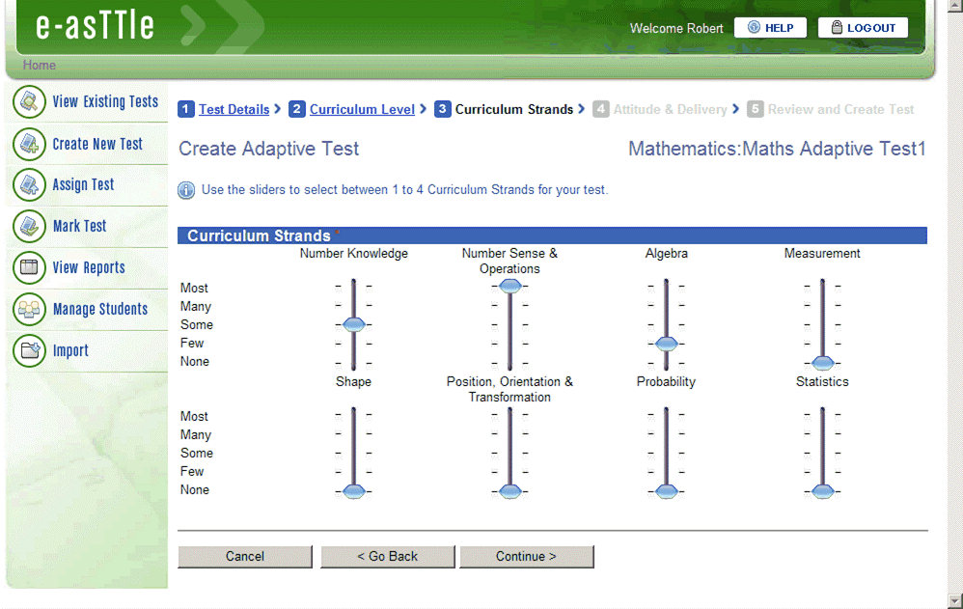
Choose Curriculum Strands
Notes:
38

Slide 39
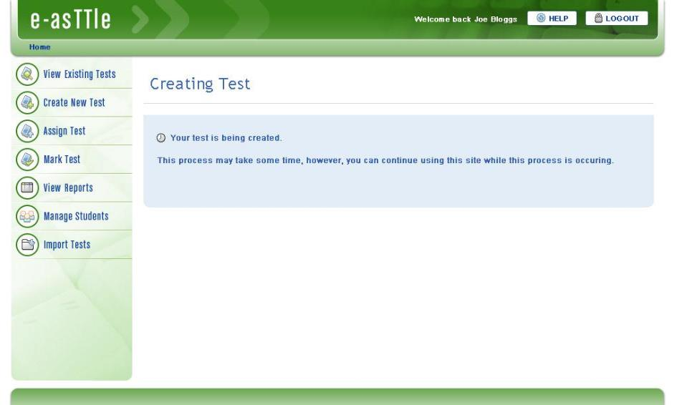
Create a test

Slide 40
Reporting to Teachers
Notes:
40
40

Slide 41
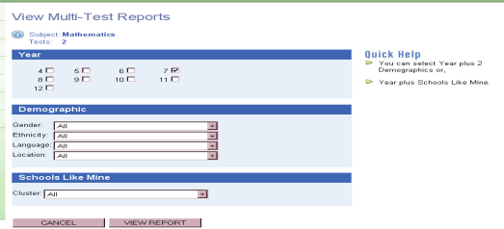
School level Report

Slide 42
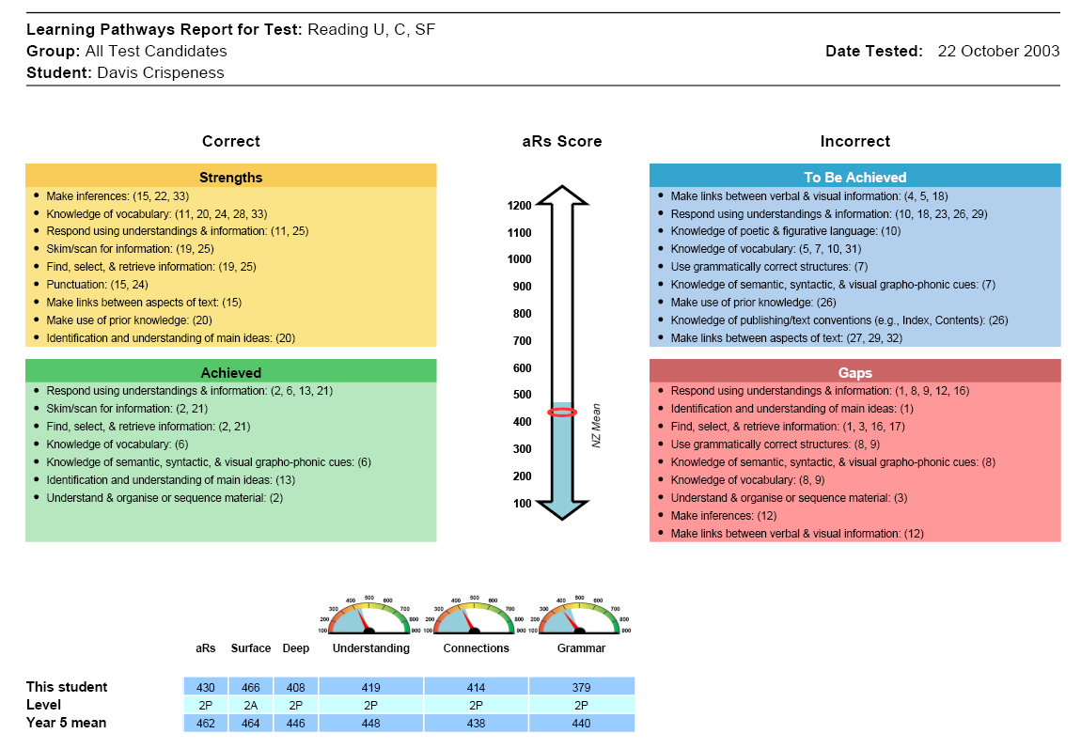
Individual Learning Pathways
Notes:
42

Slide 43
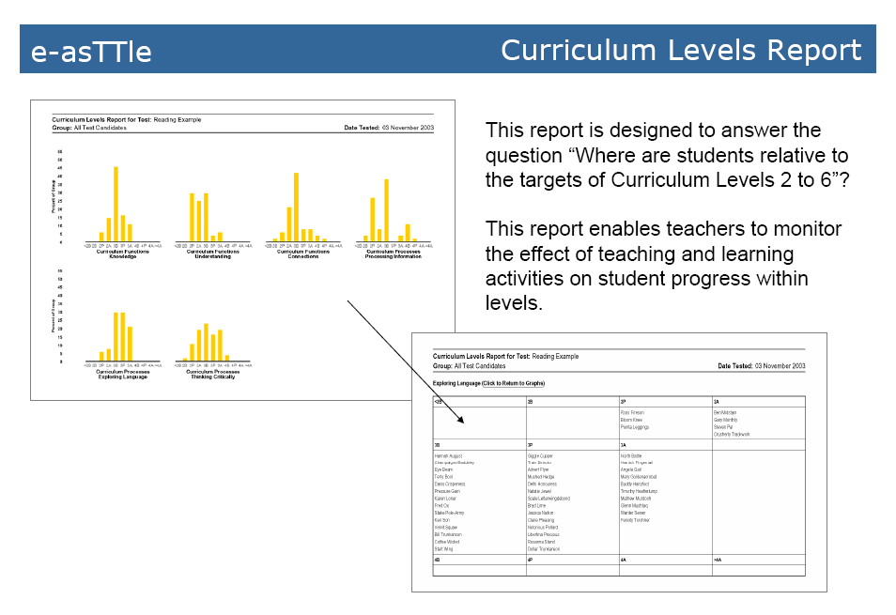
Curriculum Level Report
Notes:
43

Slide 44
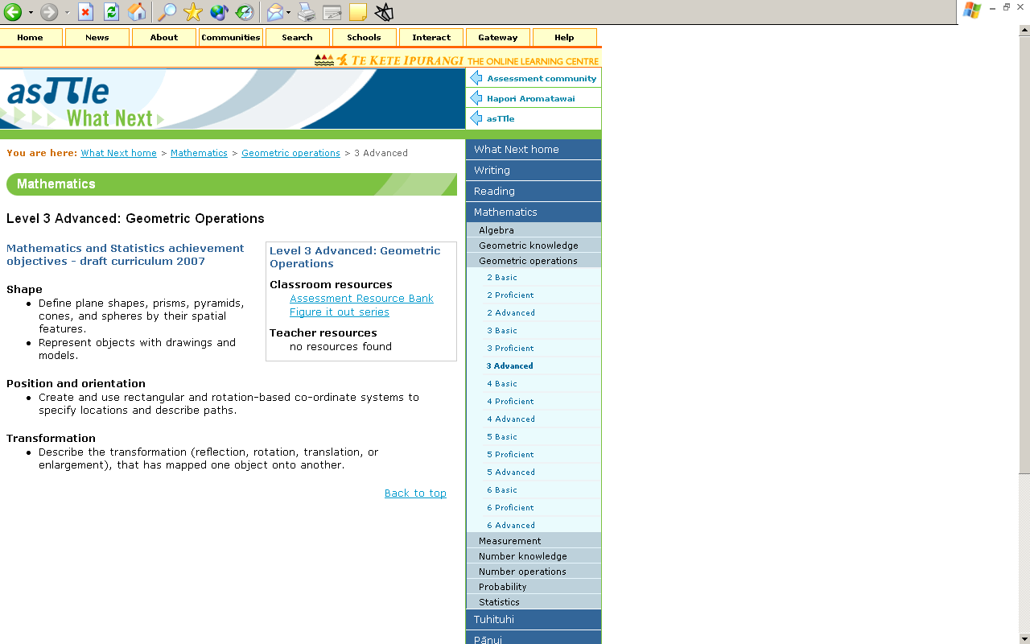
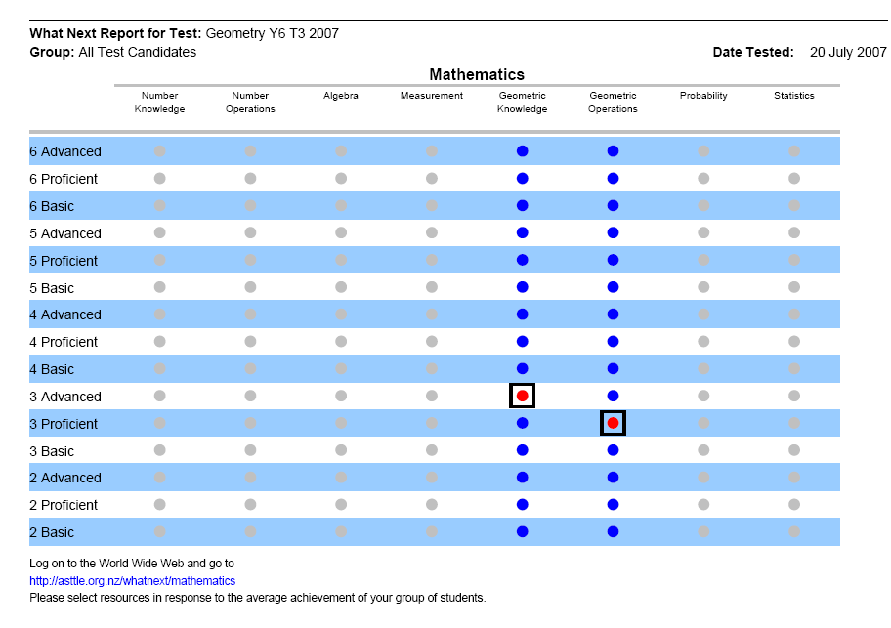
What Next Report
Notes:
44

Slide 45

To DIE for:
7
Diagnose
Teachers are to DIIE for
Interventions
Implement
Evaluate

Slide 46

8
I work with other teachers to develop common conceptions of progress

Slide 47

School leaders that legitimate, support, and esteem collective efficacy
9
  Moving from “plans & good intentions” to “purposeful practice” for all
Construct narrative of impact
Joint ownership of all students, all successes
Build trust
Ensuring all are involved

Slide 48

LEADS TO:
Collective efficacy - “a group’s shared belief in the conjoint capabilities to organize and execute the courses of action required producing given levels of attainment” (Bandura, 1997, p. 477)

Slide 49

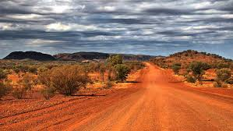
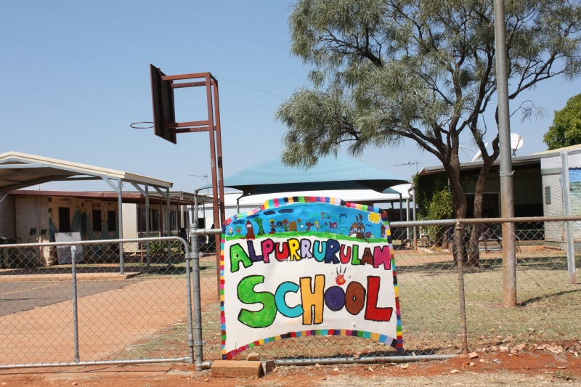

Slide 50
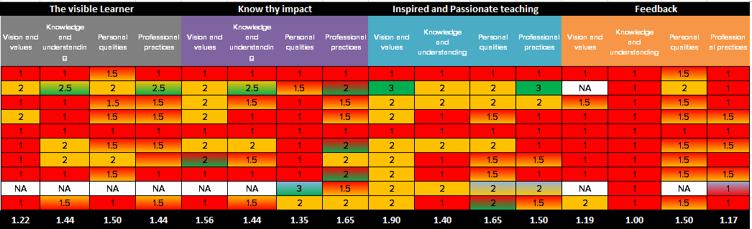
Building School Capability: 2012 - 2015
The Visible Learner
Know thy Impact
Inspired and Passionate teaching
Feedback
Vision and values
Knowledge and understanding
Personal qualities
Professional practices
Evidence
School Climate
Strategic Planning
Positions allocation & responsibilities
Professional Development program
Lesson planning
Walk throughs & observations
Test evidence
 | Common-place and systematically embedded
 | Exists but not common-place or systematic
 | Exists but in small pockets
 | Not established practice
Baseline

Slide 51
Building School Capability: 2012-2015
 | Common-place and systematically embedded
 | Exists but not common-place or systematic
 | Exists but in small pockets
 | Not established practice
Baseline

Slide 52
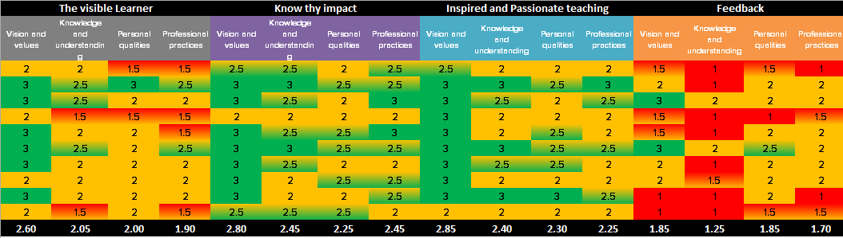
Building School Capability: 2012-2015
 | Common-place and systematically embedded
 | Exists but not common-place or systematic
 | Exists but in small pockets
 | Not established practice
Impact Cycle 1
Baseline

Slide 53
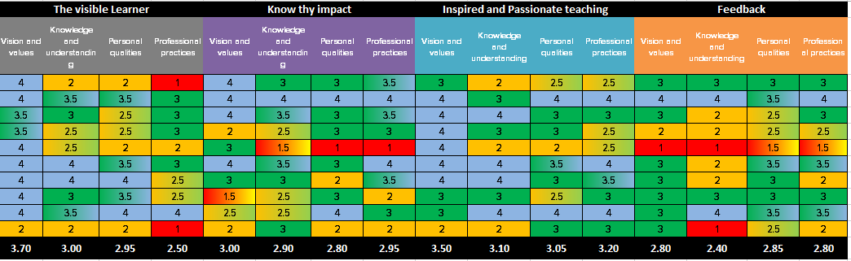
Building School Capability: 2012-2015
 | Common-place and systematically embedded
 | Exists but not common-place or systematic
 | Exists but in small pockets
 | Not established practice
Impact Cycle 2
Impact Cycle 1
Baseline

Slide 54
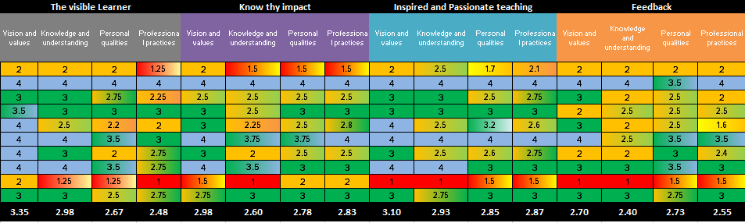
Building School Capability: 2012-2015
 | Common-place and systematically embedded
 | Exists but not common-place or systematic
 | Exists but in small pockets
 | Not established practice
Impact Cycle 3
Impact Cycle 2
Impact Cycle 1
Baseline

Slide 55
Ye It can be done!
I Collaborate
)
Teachers & students, working together, as evaluators of their impact .90
All having high expectations .90
All moving towards explicit success criteria .77
Using the Goldilocks principles of challenge .74
Errors and trust are welcomed as opportunities to learn .72
4. Maximize feedback to teachers about their impact .72
5. A focus on learning: The right proportions of surface to deep .69

Slide 56

Building teachers’ collaborative efficacy
5

Slide 57






VL Science
VL for Parents
VL for feedback
Assessment capable students
Teaching as a Profession

