Slide 1
THE SINGAPORE ADVENTURE LEAP Conference, August 2017 Nicholas Tang

Slide 2
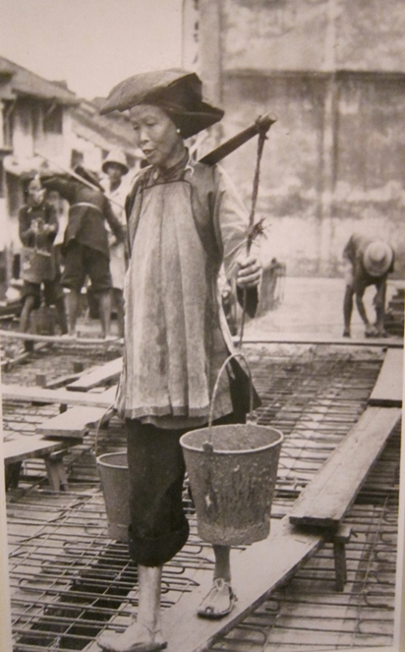
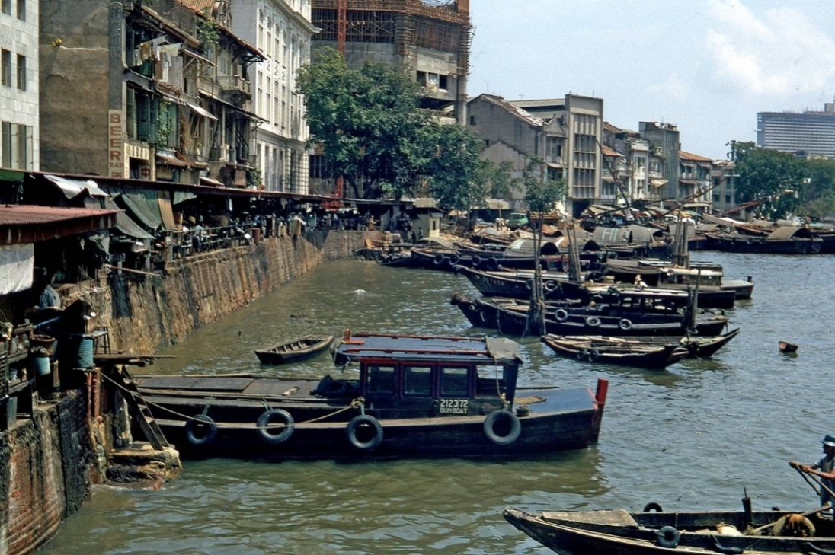
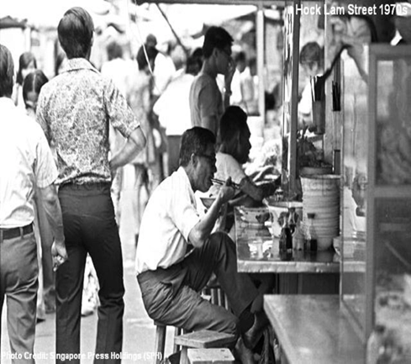

Slide 3
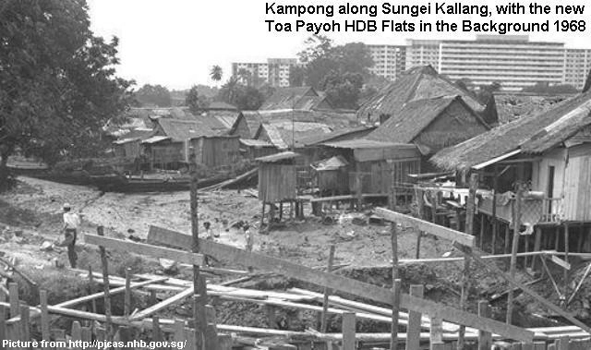
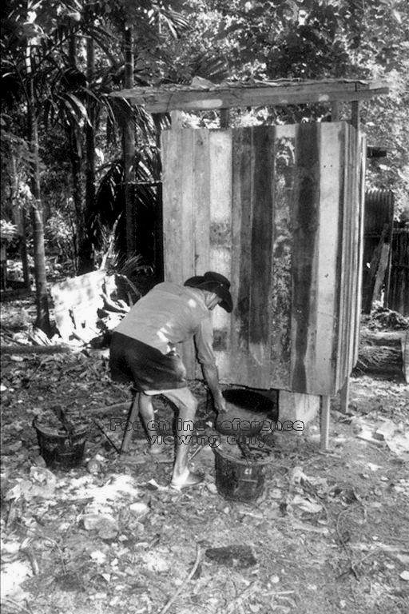

Slide 4
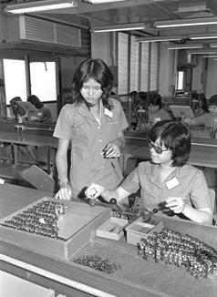
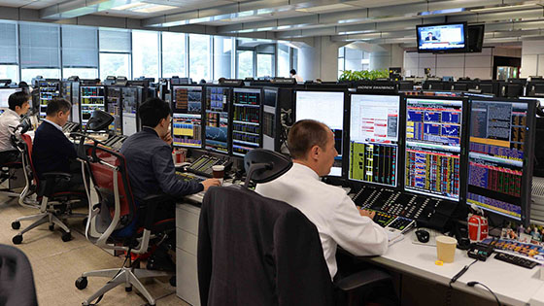

Slide 5
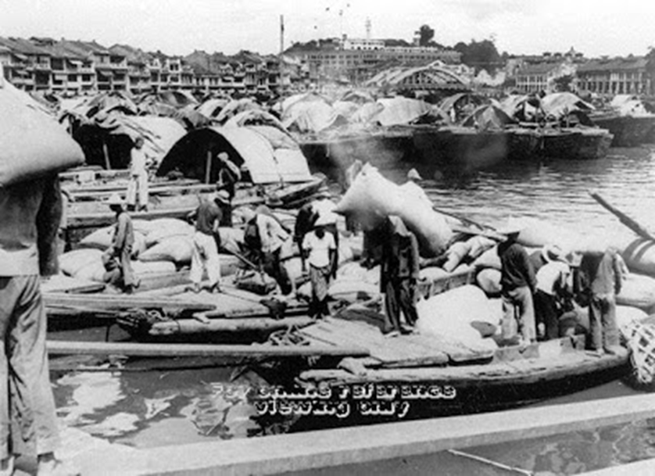

Slide 6
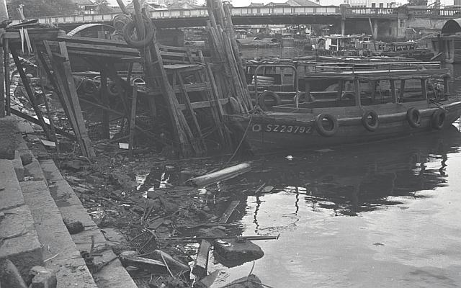
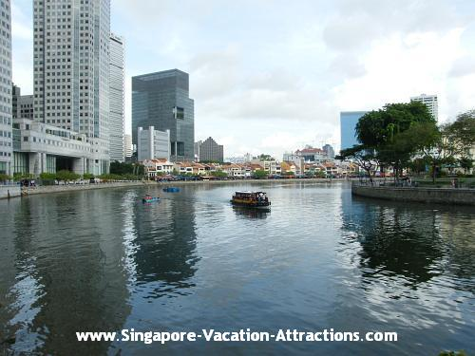

Slide 7
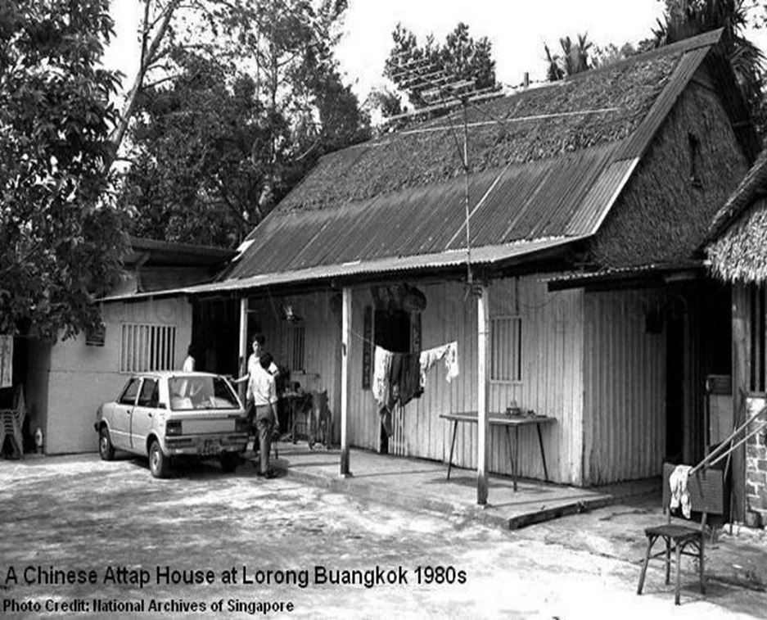
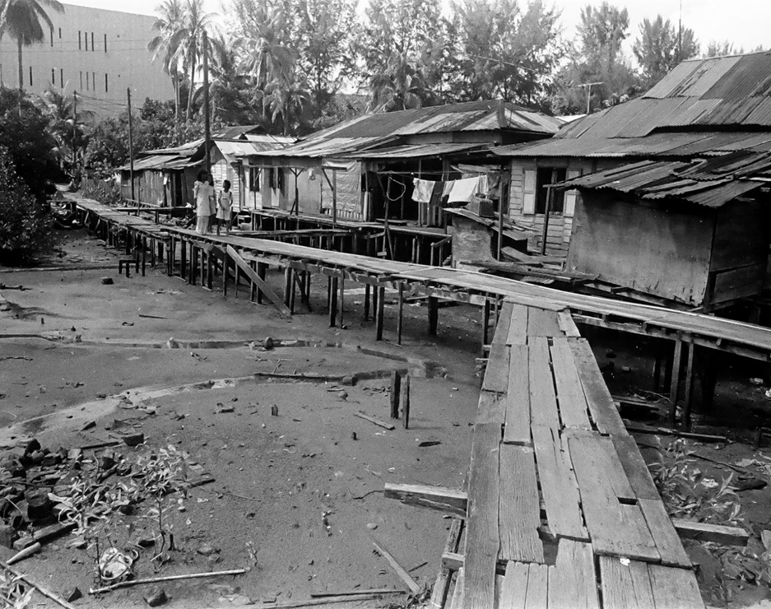
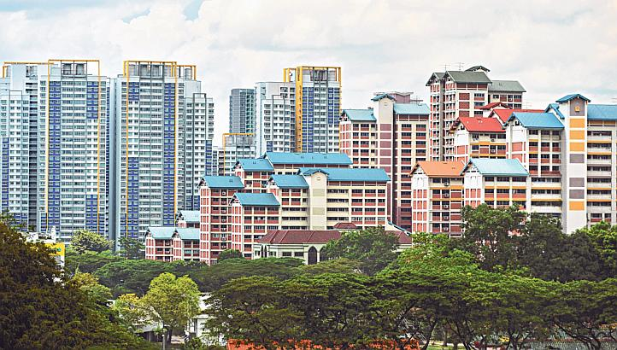

Slide 8
education

Slide 9
Key Phases in Singapore Education
1965 - 1978: Survival-driven education
1978 - 1997: Efficiency-driven education
Teacher-proof curriculum
1997 onwards: Ability-driven education
“Thinking Schools, Learning Nation” initiative
Curriculum-proof teachers
2017: Uncertainty-driven education?

Slide 10
How Does Singapore Recruit, Develop and Retain the Curriculum-proof Teachers ?

Slide 11
10

Slide 12
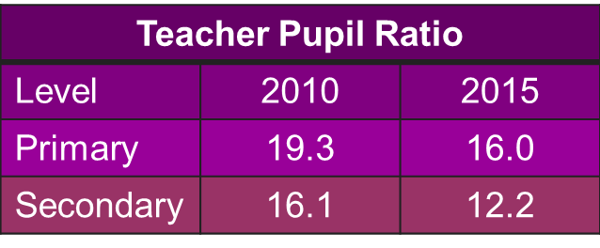
Snapshot of Singapore Education
Number of Schools | 366
Enrolment (2015) | 454,697
Average Class size | 32.7
Number of Teachers | 33,105
Number of Principals | 378
Number of Vice-Principals | 657

Slide 13
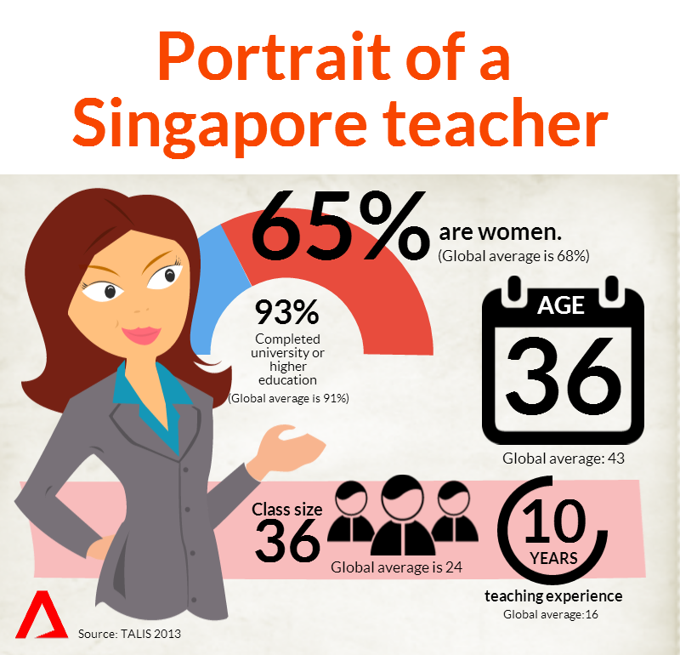

Slide 15
“just as a country is as good as its citizens, so its citizens are, finally, only as good as their teachers”
Lee Kuan Yew, 1966

Slide 16
Recruit
Status
Process
Develop
Initial Teacher Training
Performance Management System
Professional Development
Retain
Competitive Salary
Career Path
Retention Plan
Effective School Leadership

Slide 17
It is the status in society, the respect which fellow citizens hold you in, which is crucial in attracting to, and retaining, within the teaching service, a hard core of men and women in the schools who can maintain the high standards.
Lee Kuan Yew, 1972

Slide 18
Status
Comprehensive branding and marketing of teaching over many years

Slide 19
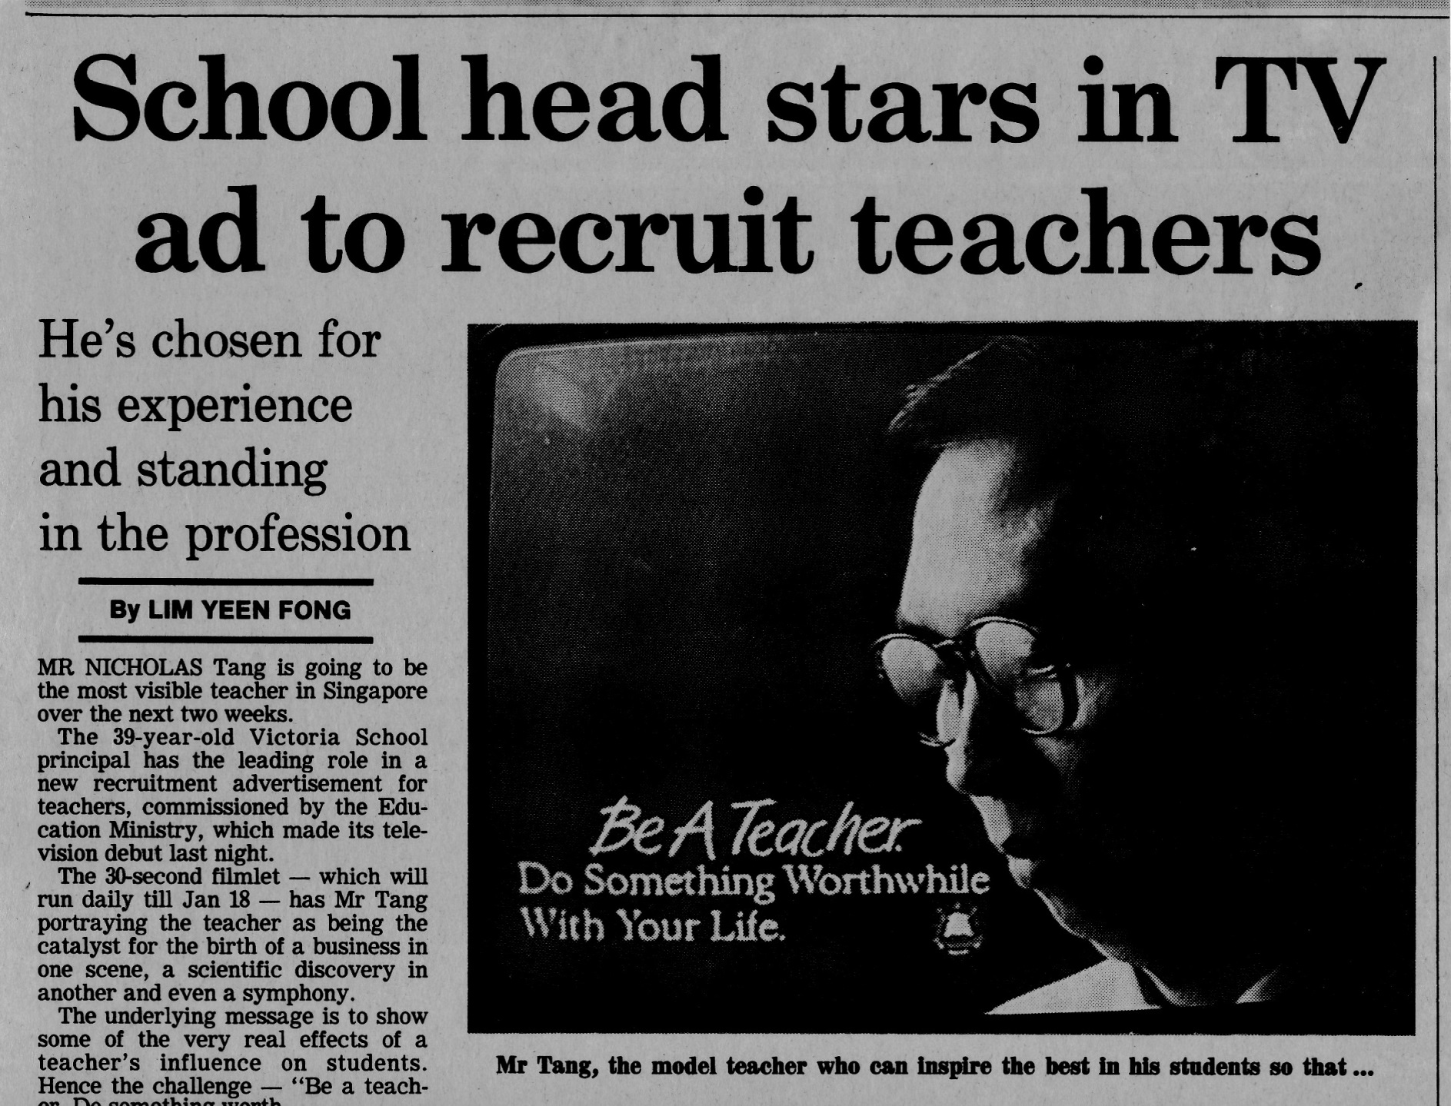
1987

Slide 20
Status
Comprehensive branding and marketing of teaching over many years
Competitive salary – starting salary matches that of accountants and engineers in the civil service
Greater autonomy and advocacy
More explicit public recognition of teachers

Slide 21
Status
Retain

Slide 22
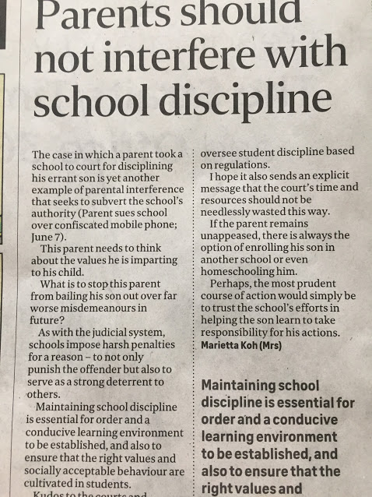
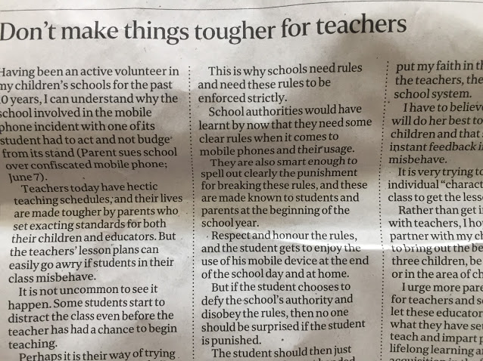
Status

Slide 23
Secret #1 A consistent and long-term national effort led to significant improvement in the status and image of teachers

Slide 24
ONLY THE BEST
Process
How
Criteria
Formal qualifications
Entrance Proficiency Test (Language)
Interview
Monitoring at NIE
Completed relevant* education
Top 30% of age cohort in academic qualifications
High level of literacy
Must have correct attitude, aptitude and personality (interviewed by panel of 3 experienced school principals)
Evidence of interest in children and education (practicum)
NTU-NIE Teaching Scholarship Programme – important for attracting talent and status

Slide 25
Develop
Initial Teacher Training
Performance Management System
Professional Development

Slide 26
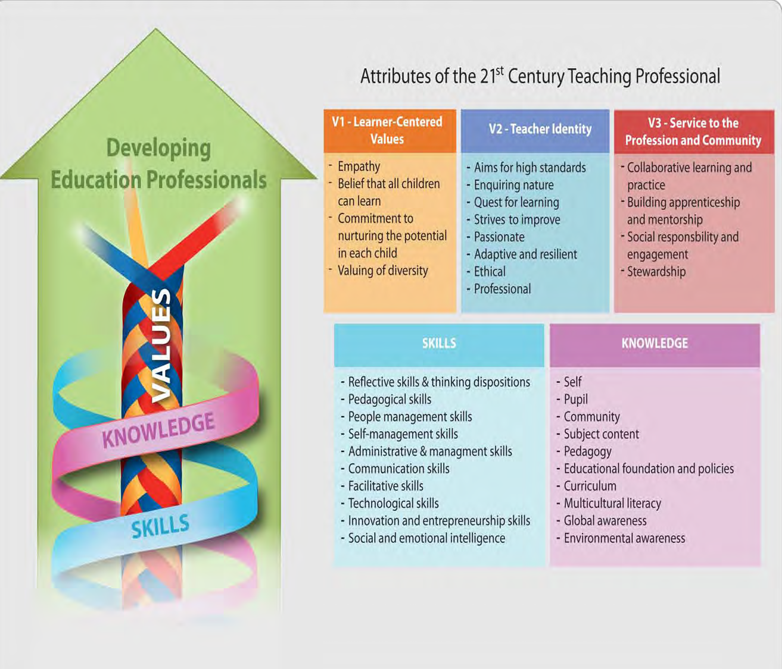
Initial Teacher Training
MOE

Slide 27
What is the first thing that strikes you when you see this framework ?

Slide 28
Values at the core – the ‘why’ of teaching and not just the ‘how’
Initial Teacher Training
MOE
MOE
Teacher Education
Schools
NIE

Slide 29
Secret #2 Ensures that the teacher has the right values and not just the teaching skills
Initial Teacher Training

Slide 30
Secret #3 Collaboration between policy makers, academics and practitioners
Initial Teacher Training

Slide 31
ENHANCED PERFORMANCE MANAGEMENT SYSTEM (EPMS)
Self-evaluation tool
Identifies training needs
Work review cycle is used for coaching/
mentoring
Work Review
Performance Bonus, Salary Increases, Tenure, Promotions
Current Estimated Potential (CEP)
Performance Management

Slide 32
Secret #4 Clear expectations and PD is directly linked to performance
Performance Management

Slide 33
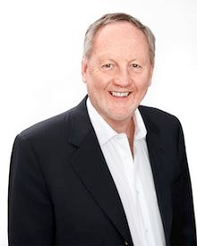
Nothing has promised so much and has been so frustratingly wasteful as the thousands of workshops and conferences that led to no significant change in practice when teachers returned to their classrooms
: Fullan, 1991
Professional
Development

Slide 34
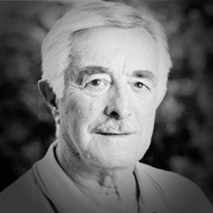
“very much like taking out a piece of a jigsaw (school organisation), changing its shape and then finding it will not fit when you try to put it back. Not only will the piece not fit but it then has to suffer the anguish and frustration of being ‘knocked’ back into its original shape so as to fit it with the total jigsaw. This suggests that for effective change the total school, all the pieces of the jigsaw, need to be involved.”
(Mulford, 1980)
Professional Development

Slide 35
TEACHER-LED PROFESSIONAL DEVELOPMENT
Professional Development
Teacher-led reflective PD – Teachers Network in 1998 and Academy of Singapore Teachers in 2010
PD goes beyond traditional workshops to include Professional Learning Communities, Networked Learning Communities, Subject Chapters, school visits, conferences, sabbatical leave

Slide 36
Professional Development

Slide 37
Learning Circle
Conference
Publications
READ@TN
iCARE
Provided safe space to learn from peers
Enhanced Collegiality
Helped teachers make explicit their implicit expertise
Helped teachers clarify and articulate their assumptions and reasons underlying practice
Teacher advocacy
Professional Development

Slide 38
Professional Development
Designed by teachers for teachers - advocacy

Slide 39
The Teacher Growth Model (TGM) is a professional development model aimed at encouraging teachers to engage in continual learning, and take ownership of their professional growth and personal well-being.
Teachers have the autonomy and flexibility to plan their PD.
Multiple modes of learning and using different platforms
Ensures that teachers acquire KSVs needed to nurture 21st competencies in the classroom
Professional Development

Slide 40
Unconscious Incompetence
Conscious Incompetence
Conscious Competence
Unconscious Competence
Professional Development

Slide 41
Secret #5 Holistic PD provisions to cater to different needs, stages of professional competence, and learning styles: a) formal accredited and certificated courses; b) traditional training courses; c) contextualised teacher-led learning; d) personal identity and self-mastery workshops.
Professional Development

Slide 42
STRUCTURAL ENABLERS
Professional Development
100 hours of paid PD activities each year
$400 ($700 after the 15th year of service) each year to enable them to invest in activities or tools for their PD
Professional Development Leave (Sabbatical) after 12 years
Study loans, grants or full scholarships for non-graduates to pursue a degree course and graduates to pursue post-graduate qualifications
No-pay, full-pay or part-time employment for teachers pursuing relevant full-time courses
Time-tabled (protected) time for PD
School Staff Developer in every school

Slide 43
GROW Package (2008)
Professional Development Packages Greater Support for Postgraduate Studies More In-Service Upgrading Opportunities for Non-Graduate Teachers Growth | New Education Scheme of Service (2008) Revised CONNECT Plan Additional Outstanding Contribution Awards Recognition
Enhanced Senior Specialist Track Further Re-employment Opportunities Future Leaders Programme Opportunities | Expansion of Part-time Teaching Scheme Greater Support for Part-time Teaching Enhancements to No-Pay Leave Well-Being
Develop
Retain

Slide 44
Secret #6 Substantial financial and structural support Note: Education takes up between 20% to 25% of Government expenditure or approximately 3.5% of GDP
Professional Development

Slide 45
Retain
Competitive salary
Career path
Retention plan
Effective School Leadership

Slide 46
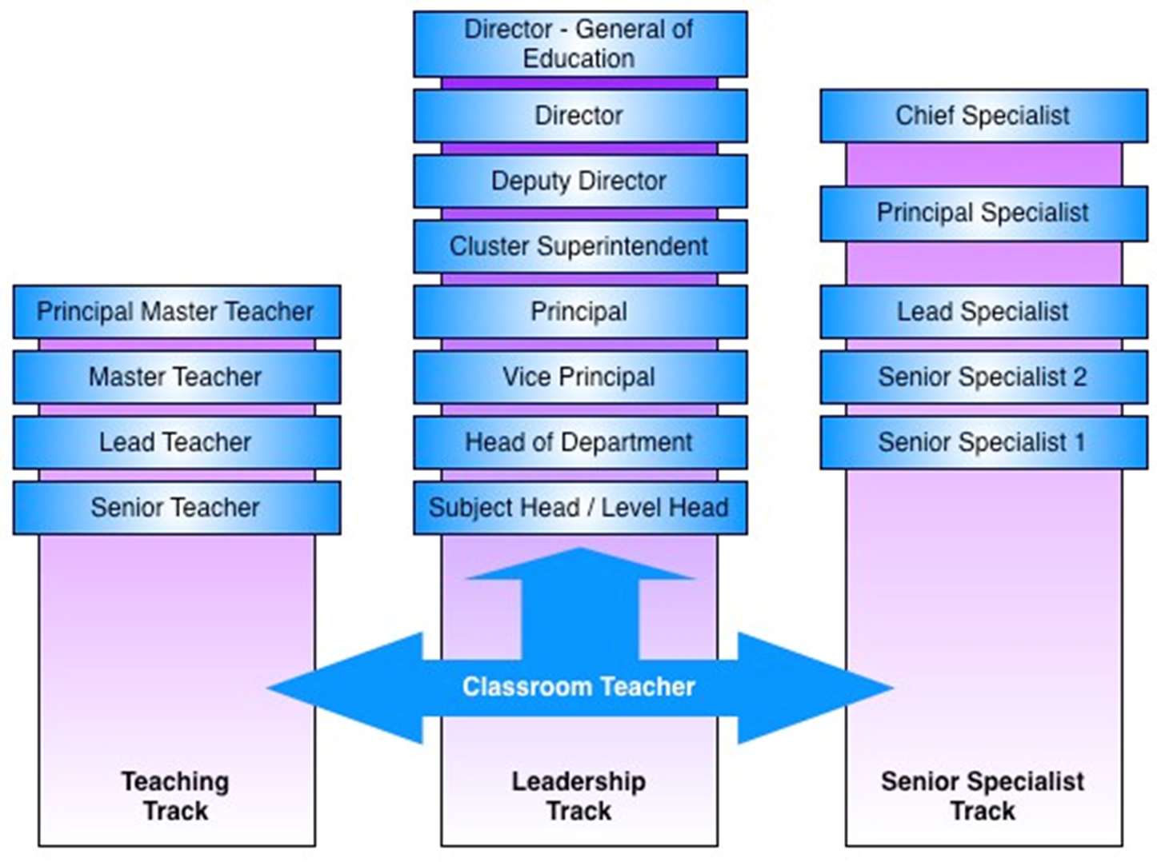
Career Pathways
Develop
Retain

Slide 47
Do you like it ?
Why?

Slide 48
CONNECT (Retention) Plan
Retain
CONNECT Year | Graduates | Non-graduates
1 | - | -
4 | $15,200 | $10,800
7 | $24,000 | $17,200
10 | $25,900 | $18,200
15 | $36,100 | $27,300
20 | $28,500 | $21,400
25 | $18,500 | $13,800
30 | $20,600 | $15,500

Slide 49
TEACH Framework (2011)
Develop
Retain

Slide 50
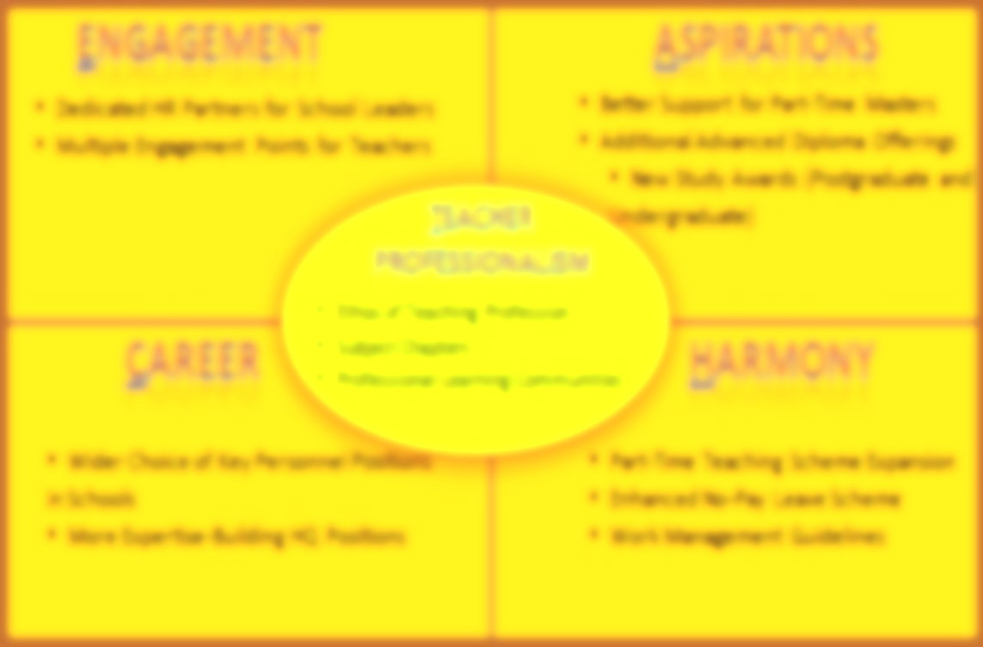
Improving communication with teachers
More opportunities for academic advancement to meet the aspirations of teachers
Culture of self-led professional development
Develop
Faster career advancement by providing more leadership positions
Better work-life balance to retain good teachers
Retain

Slide 51
The policies are consistent and complementary
It is NOT a linear process but loops
RECRUIT
RETAIN
DEVELOP

Slide 52
Secret #7 Systemic coherence based on best HR practices – recruit the best; invest in developing the people; clearly communicate your expectations; retain your top talent

Slide 53
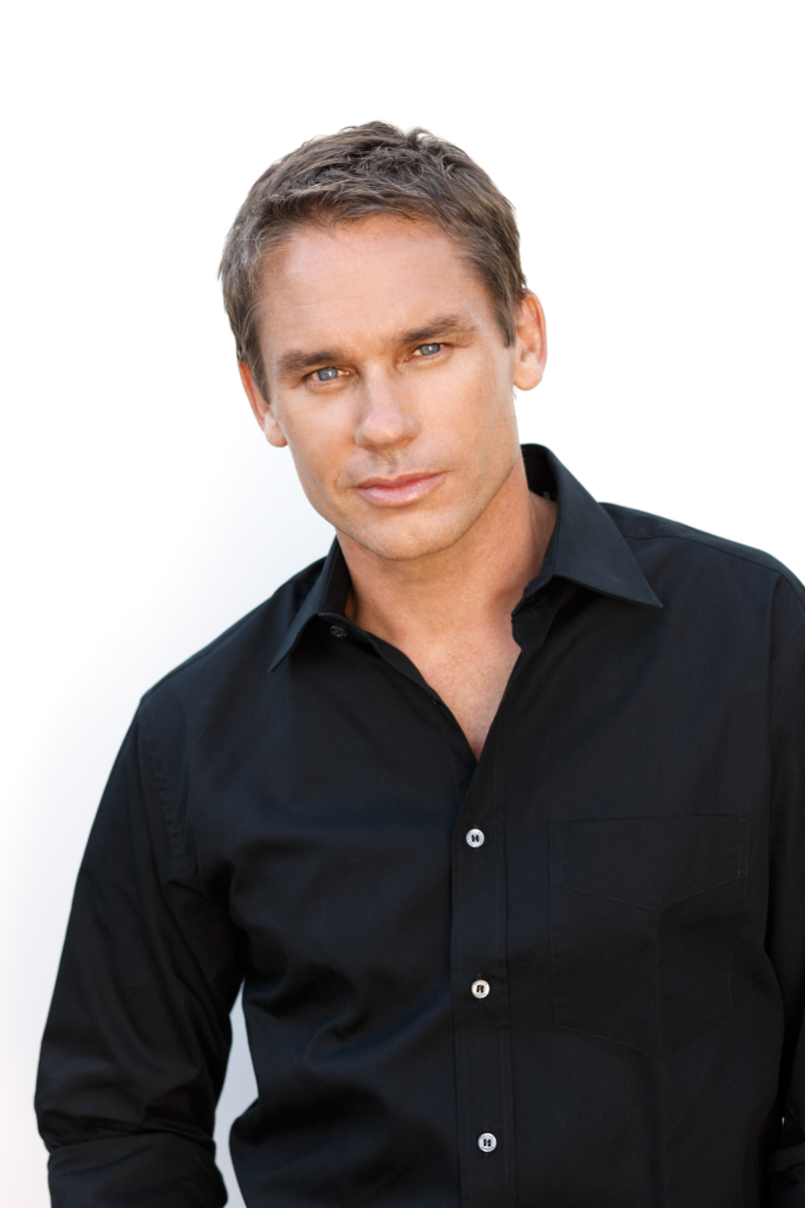

Slide 54
Philosophy of Educational Leadership
2007 MOE Press Release
Principle 1: Educational Leadership is anchored in Values and Purpose
This is the lead principle as it underscores the development of our leadership efforts towards values-based leadership. This belief underlies the purpose of Principalship: to lead schools to provide our children with a well-rounded education.
Principle 2: Educational Leadership inspires all towards a Shared Vision
The Principal set clear directions and ensures that the vision is focused on student learning and development.

Slide 55
Principle 3: Educational Leadership is committed to Growing People
The Principal values all staff as individuals and professionals and looks into their development and growth by building their capacity.
Principle 4: Educational Leadership Leads and Manages Change
The Principal is prepared for future changes and always remains innovative and improvement-driven. His leadership builds on the past, learns from the present and prepares for the future.

Slide 56
Selection & Training of School Leaders
Identification Through EPMS
Interview by senior management at MOE
17 weeks Management & Leadership in Schools (MLS) programme
6 months
Leaders in Education Programme (LEP)

Slide 57
Professional Development of Principals
Similar model and PD provisions as teachers
New posting after 4 to 6 years
360 degrees feedback after 1 and 3 years
2 months sabbatical after 6 years
Milestone Courses

Slide 58
Secret #8 Systemic coherence : - identify and select the best; - ensure that they are trained for the role; - invest in their continual professional growth; - clearly communicate your expectations; - reward and retain your performers

Slide 59
Secret #9 Maintaining a judicious balance between school autonomy and central control

Slide 60
Secret # 10 Give teachers (and school leaders) the motivation, reason and space to grow

Slide 61
Key Principles
The quality of education is determined to a large extent by the quality of teachers and school leadership
Best HR practices are relevant to improving teacher quality.
Teachers are professionals and not missionaries;
Teaching is more than a calling - it is a career;
Systemic coherence and consistency – the whole is larger than the sum of its parts
Genuine collaborative and reciprocal partnership between policy-makers, academics and practitioners
Political commitment and a culture that respects teachers and teaching

Slide 62
Crabs in a Bucket mentality
“If I can’t have it, neither can you”

Slide 63
Never doubt that a small group of thoughtful, committed citizens can change the world. Indeed, it is the only thing that ever has.
Margaret Mead
You must be the change you want to see in the world
Mahatma Gandhi

Slide 64
Thank You

