Slide 1
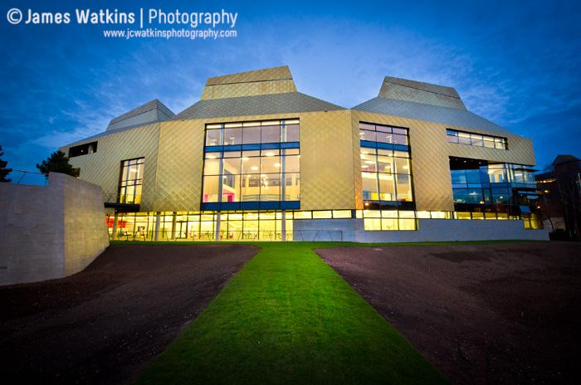
LEAP 2015
“Grasping the agenda”
Sydney, Australia

Slide 2
“It is one of life’s great ironies: schools are in the business of teaching and learning, yet they are terrible at learning from each other. If they ever discover how to do this, their future is assured”
Michael Fullan 2001
2

Slide 3
Start with the question..
WHY ?
Thinking from the work
on
‘The Golden Circle’
Simon Sinek

Slide 5
The problem with management..
Time to read, reflect and share your thoughts with a neighbour
The centrality of establishing
CORE VALUES
This is how WE will work together

Slide 6
What might this mean in a school?
S survivors | B believers
F fundamentalists | T tweenies

Slide 7
Video Clip
The USS Montana and the Irish Lighthouse

Slide 8
The Minister for Education Adrian Piccoli
“we need school leaders who can lead the professional collaboration and ongoing learning of teachers in their schools”
“implementation detail is rightly the job of the individual school authorities”
“we now have a world-class blueprint”
Great Teaching, Inspired Learning, March 2013

Slide 9
Collaboration
Establishing, strengthening and extending partnerships
The power of collective capacity is that it enables ordinary people to do extraordinary things

Slide 10
Collective capacity
Collective capacity generates the emotional commitment that no amount of individual capacity working alone can come close to matching
Working together generates commitment
Moral purpose stares you in the face; it becomes palpable and indeed truly irresistible
The collective motivational well seems bottomless
The speed of effective change increases exponentially
McKinsey and Company 2010

Slide 11
Trust and Verify; the real keys to school improvement
PARANOIA
LOW
TRUST
CONDITIONAL
TRUST
HIGH
TRUST
BLIND TRUST
INTRUSIVE
VERIFICATION
LIGHT TOUCH

Slide 12
Video Clip
You tube clip of man in a wardrobe

Slide 13
Alliances, agreements, friendships and coalitions can often pay their way by giving all of us more returns than we could have had by going down the path of outright competition... The trick of getting cooperation to work is somehow to contain the conflict before it consumes the riches that could otherwise be shared.

Slide 14
National Standards of Excellence for Headteachers
The Four Domains
Qualities and Knowledge
Pupils and staff
Systems and Process
The self-improving school system
These standards are designed to inspire public confidence in headteachers, raise aspirations, secure high academic standards and empower the teaching profession

Slide 15
Key words and phrases in the new standards
Leading by example with.. integrity, creativity,
Resilience and clarity…
Occupying an.. Influential position, shaping the profession having clear values and ambition
Developing effective relationships, achieving excellence, shaping the future based on well evidenced research drawing on their own scholarship..

Slide 16
In the self-improving school system in England, Headteachers need to:-
Create outward-facing schools which work with other schools and organisations , in a climate of mutual challenge,to challenge educational orthodoxies,harnessing the findings of well evidenced research, model entrepreneurial and innovative approaches to school improvement.
Principals maintain their values… Build a culture of trust and collaboration.. Base change and innovation on research.
Australian Professional Standards for Principals

Slide 17
‘Schools should become hubs of cutting-edge research into education in an attempt to speed up innovation.’
Andreas Schleicher, Deputy Director for Education at
PISA ( Programme for International Student Assessment), 2013

Slide 18
Christine Gilbert ex- Chief inspector, OFSTED wrote, recently I an article, ‘Towards a self-improving system’,
‘to pass muster, schools would need to show that their self assessment included external scrutiny’

Slide 19
A person (adult and pupil) will be better equipped to deal with the world, through
A synthesising mind
A disciplined mind
A creating mind
A respectful mind
An ethical mind
Howard Gardner- Five Minds for the Future
The CRAFTS of leading and learning

Slide 20
A professional learning community is:
. . .
an inclusive group of people, motivated by a shared learning vision, who support and work with each other, finding ways, inside and outside their immediate community, to enquire on their practice and together learn new and better approaches that will enhance all pupils’ learning.
Stoll et al (2006)

Slide 21
Layers of Self regulation in School Improvement
Local Network
National Network
International Network
Creation of a Virtual International Leadership Academy

Slide 22
Video Clip
Report of field of burning weed

Slide 23
No matter the storm, there’s always a rainbow waiting

Slide 24
Learning from Noah’s Ark
1 Don’t miss the boat
2 Remember we’re all in the same boat
3 Plan ahead. It wasn’t raining when Noah built the Ark
4 Stay fit. When you’re 600 years old, someone may ask you to do something really big
5 Don’t listen to critics; just get on with the job that
has to be done

Slide 25
6 Build your future on high ground
7 For safety’s sake, travel in pairs
8 Speed isn’t always an advantage;
the snails were on board with the cheetahs
9 When you’re stressed, float awhile
10 Remember the Ark was built by amateurs,
the Titanic by professionals

Slide 26
The woodpeckers may have to go

Slide 27
Final thoughts
Sport, the leadership nets and more..
The Chinese Bamboo, it takes time
Famous people, go for it
Books, Pink, Chopra and West-Burnham
‘If we don’t get lost, we’ll never find a new route’.. A Principal from England ..
but BEWARE !!

Slide 28
Tom Whittingham t.whittingham@worc.ac.uk

