Slide 1
Developing Inquiry in Sustained Learning Communities
Judy Halbert & Linda Kaser
www.noii.ca

Slide 2
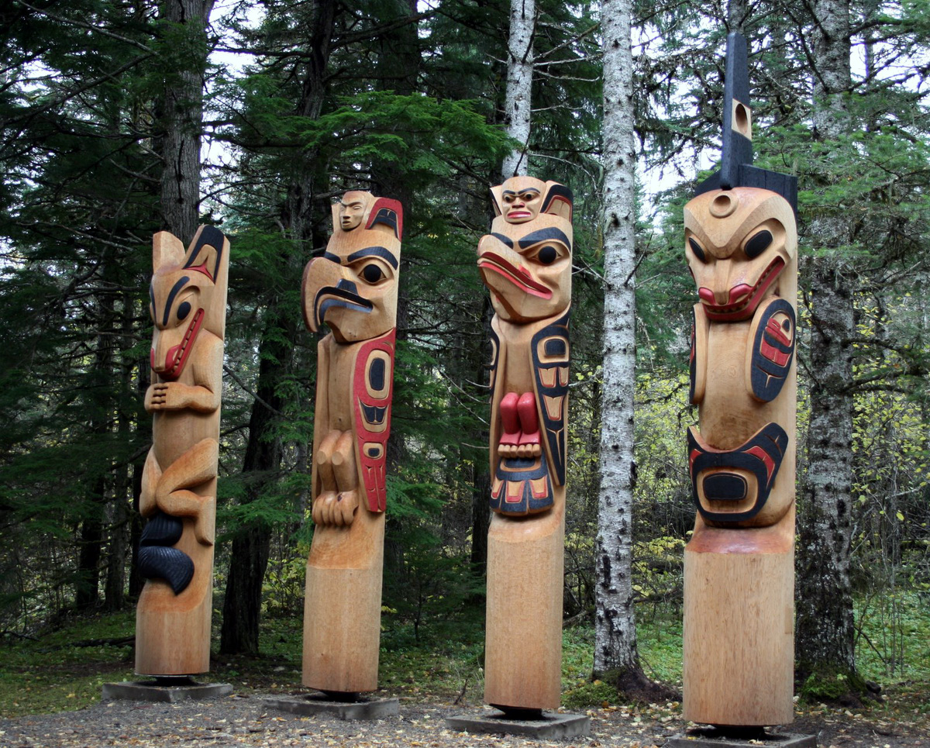
What does it take to develop and sustain inquiry learning communities?
4 questions to consider
Notes:
Gave been working with inquiry networks in BC for past 16 years.
Four questions to frame our session

Slide 3
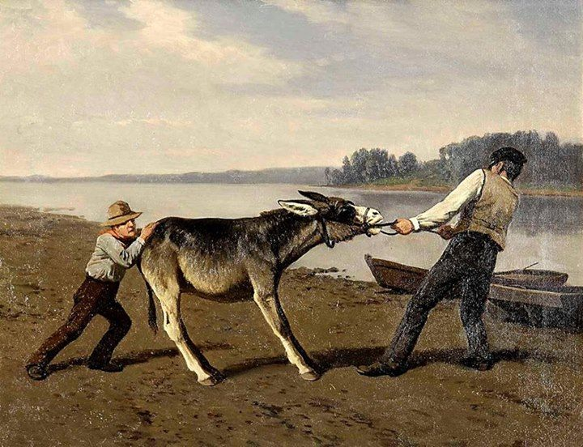
How can we use the pull of curiosity instead of the push of policy?

Slide 4
How can hard goals build motivation and teamwork?

Slide 5
Can an evidence-informed inquiry process help us achieve hard goals?

Slide 6
What action can we take immediately?

Slide 7
Pull of Curiosity
“Professional curiosity is important because….”
Notes:
Write first, then exchange ideas.

Slide 9
For young learners to be curious and engaged in their learning, they need to be supported by ADULTS who are equally curious and engaged in their own learning.

Slide 10
How do we create the conditions for
ADULT CURIOSITY
so that we can reach high quality and high equity
for all learners?

Slide 11
Why HARD Goals Matter
Heartfelt
Animated
Required
Difficult

Slide 12
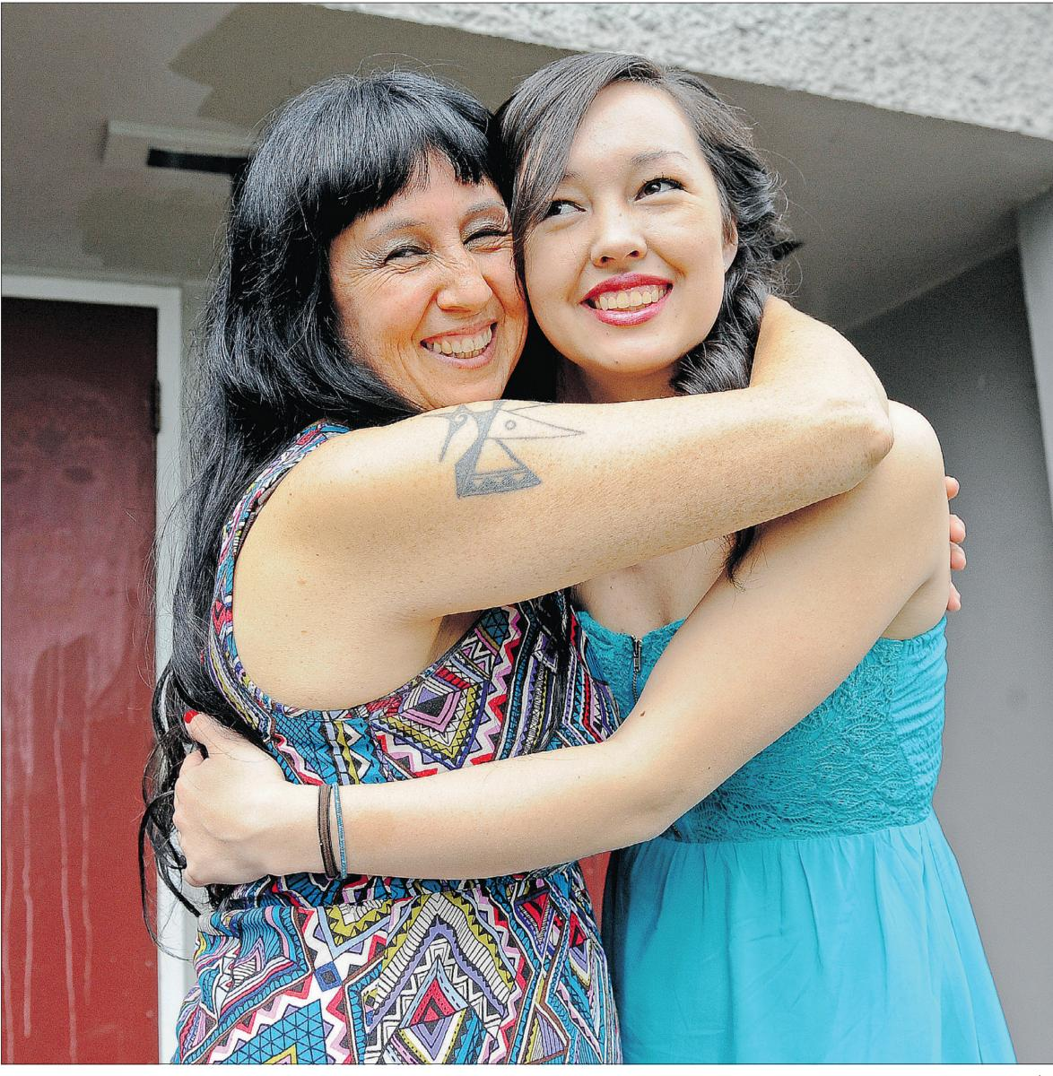
EVERY learner crossing the stage with dignity, purpose and options
Notes:
Senaqwila – vancouver windermere math 12

Slide 14
HARD Goals
What motivates you?

Slide 15
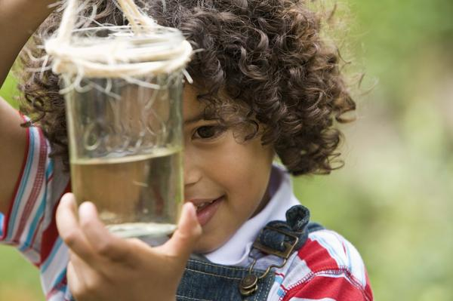
ALL learners leaving our schools MORE curious than when they arrive

Slide 16
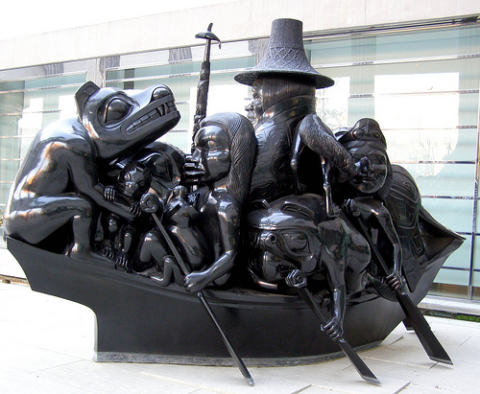
ALL learners with an understanding of and respect for an indigenous world view
Susan Point

Slide 17
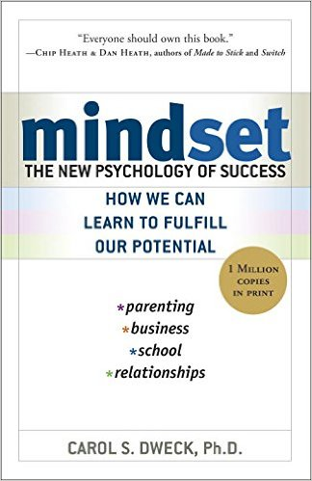
HARD Goals &
Mindset Matter
mindsetonline.com

Slide 18
Why Inquiry?
Why Now?
Evidence from
BC and Beyond

Slide 20
What happens
when the project is over
and the focused literacy support ends?
http://literacyonline.tki.org.nz/
Notes:
Focus on self-regulation and formative assessment

Slide 21
If teachers applied what they had learned in systematic ways,
new cohorts of students made gains that were similar to gains in student achievement
while participating in the LPDP.

Slide 22
When schools engaged
in an inquiry cycle
and invested in continued knowledge-building
they improved on their gains
over time.

Slide 23
One of the top performing
multi-lingual,
multi-cultural systems in the world
http://www.conferenceboard.ca/hcp/provincial/education.aspx

Slide 25
Shanghai
Hong Kong
Singapore
British Columbia

Slide 26
COMMON FEATURES
Inquiry Based
Collaborative
Linked and coherent
Professionally led
Takes place over time

Slide 27
Spirals of inquiry are spreading

Slide 28
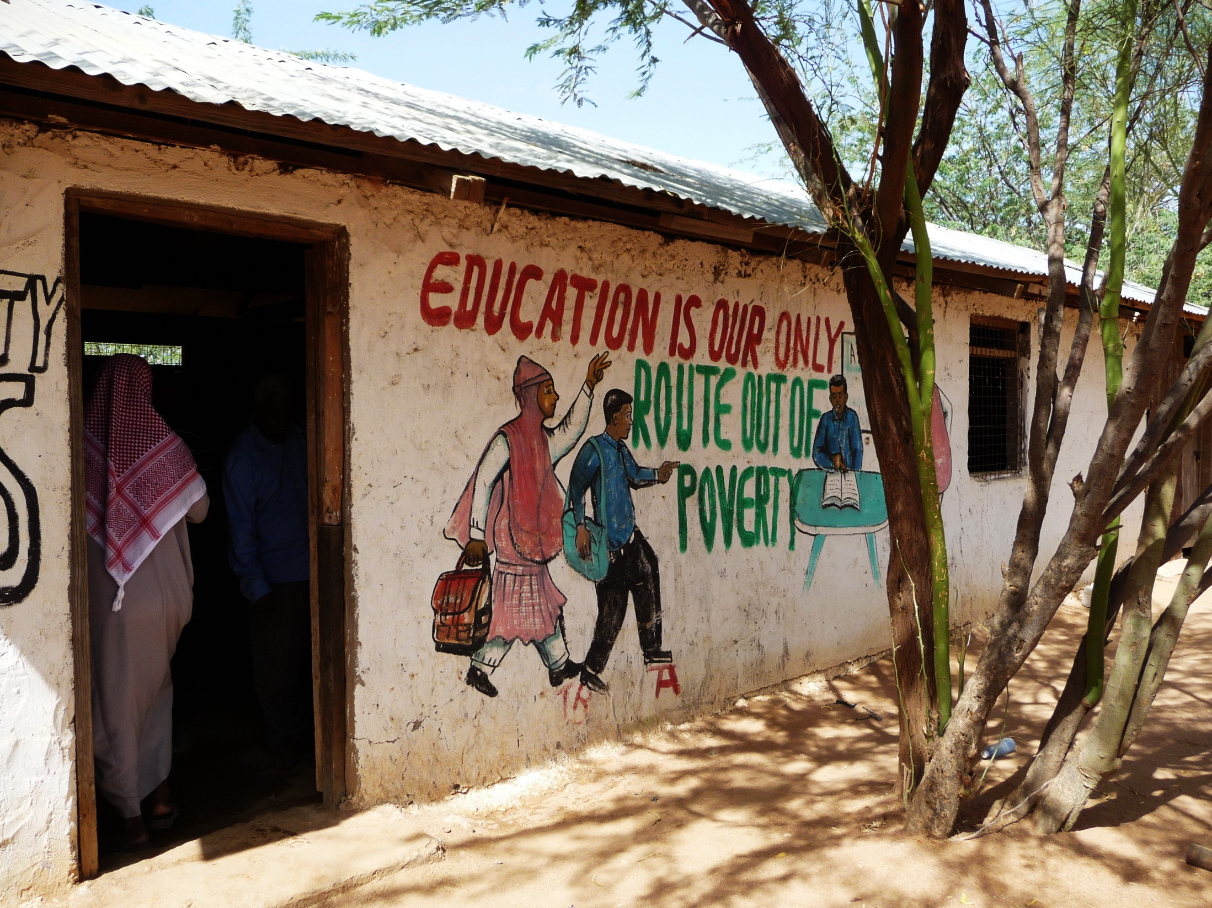

Slide 29
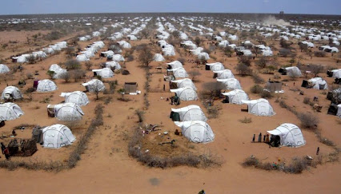
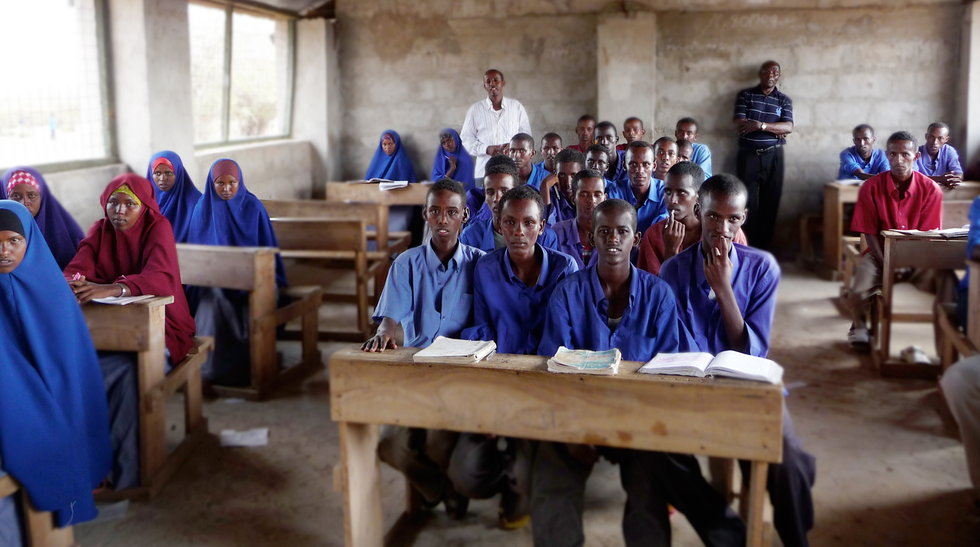

Slide 30
Spirals of Inquiry: for equity and quality A framework for professional inquiry and innovation

Slide 31
6. DISCIPLINED FRAMEWORK
The Spiral of Inquiry

Slide 32
Scanning
What’s going on for our learners?
Notes:
Time for curiosity.

Slide 33
Focusing
Where are we going to put our attention?

Slide 34
Developing a Hunch
What’s leading to this situation?
How are WE contributing to it?

Slide 35
New Learning
How and where will we learn more about what to do?

Slide 36
Taking Action
What will we do differently?

Slide 37
Checking
How will we check that we are making enough of a difference?
Notes:
Number off 1-6. Using the handout and the article, what are key pointsabout this phase

Slide 38
How might you take action immediately?

Slide 39
What’s going on for your learners?
Four Key Questions –
and why they matter

Slide 40
Can you name TWO adults in this learning setting who believe you will be a success in life?

Slide 41
What are you learning and why is this important?
How is it going?
Where to next?

Slide 42
Starting with the Four Questions
How?
When?
With whom?
And then what?

Slide 43
How can we use the pull of curiosity to create change?
What HARD goals will motivate us?
How can we use a disciplined approach to inquiry to change outcomes for learners?
Are we committed to taking action immediately on the four questions?

Slide 44
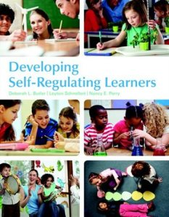

Slide 46
Thank you
www.noii.ca
jhalbert@telus.net Twitter @jlhalbert
lkaser@telus.net
Twitter @lkaser

