Slide 1
“The use of data walls to support teaching and learning”
Anne Webb
Principal, Rossmore Public School
Learnings from LEAP
ACEL Conference, 16th May,2010

Slide 2
Why data walls?
Whilst on LEAP exchange last year to The Burnham School in Cobourg, Ontario I encountered my first data wall. Being a visual learner the concept immediately appealed to me.
On returning to my school as a staff we researched different data walls used across Canada and USA. The following slides are images of data walls we harvested from the internet and used to guide us in the decision of selecting our first data wall to assist us in planning for and monitoring student growth.

Slide 3
A visual representation of school data

Slide 4
Shows results over time

Slide 5
Shows alignment between targets and results.
Notes:
Using Schoolwide Practices
: Roosevelt School in Worcester, MA has a data room where they track and post student scores using their agreed upon internal measures in Reading and Math. Posting current scores and their goals is deliberate, intentional and it keeps everyone FOCUSED on the Work.

Slide 6
Guides teaching decisions

Slide 7
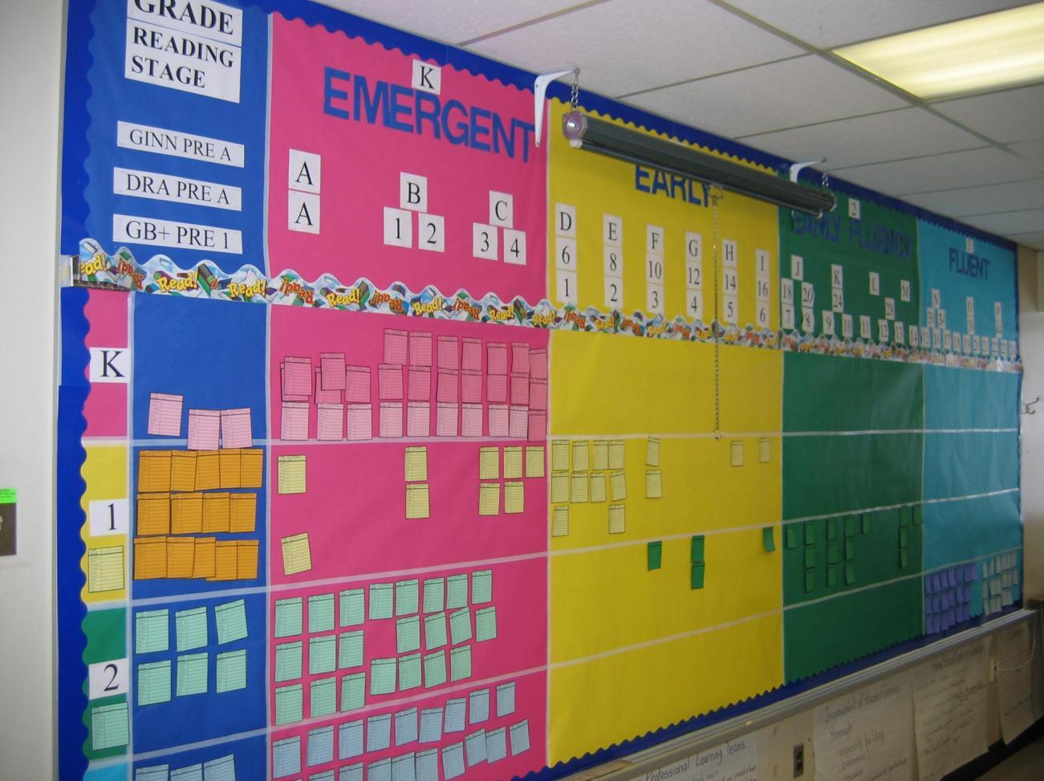
Tracks progress

Slide 8
Gives teachers a quick picture of where groupings are in order to work within their classrooms
Gives STLA an idea of where she can best help students who are struggling in the various grades.

Slide 9
Celebrating Student Growth
Students created their trains and posted their scores in the train window.

Slide 10
Student sailboats move from RED to YELLOW to GREEN (where Green is the benchmark).

Slide 11
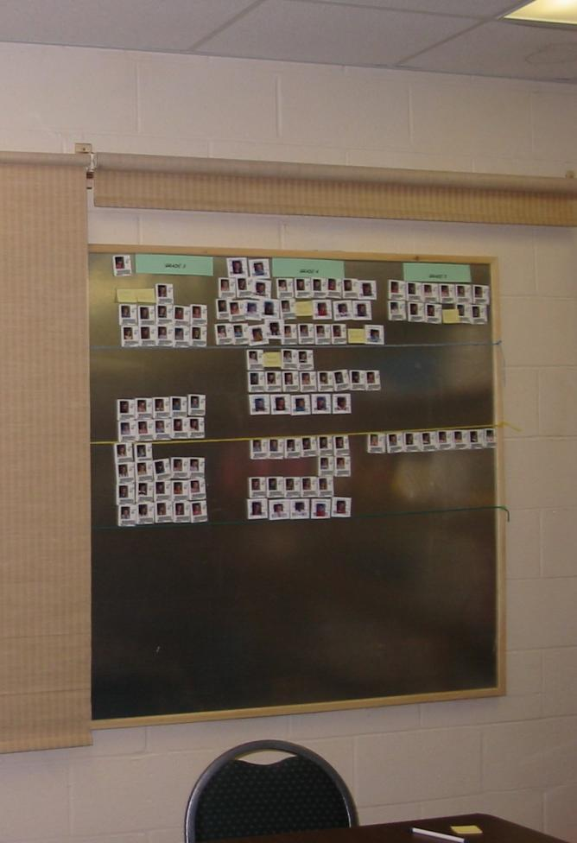
Monitoring student growth
Students’ pictures as they show growth throughout the year.
Student performance levels are posted using student I.D.s backed with magnetic tape.
Because the room is used for parent meetings, shades mounted above the board roll down to cover the confidential information displayed.

Slide 12
Posting goals and data
Staff are committed to using data to make decisions.
A school wide data wall along with data analysis charts are housed in the staff room.
Staff use this information to make decisions around teaching and learning.

Slide 13
Whilst not the most exciting display of data this is the format we have chosen to model our first data wall on at Rossmore PS identify actuals, predictions and results.

Slide 14
A data wall alone is of minimal benefit. Professional dialogue needs to be interactive with a focus on the evidence ‘of learning’ collected regularly.
Education is conversation.
Conversation creates change.
~Karl Fisch

Slide 15
Sources
http://livingthefocus.blogspot.com/
http://www.lkdsb.net/Program/elementary/admin
www.curriculum.org/LNS/networks
http://www.hpedsb.on.ca/ec/services/cst/elementary/literacy

